Slide 1
Pulmonary Cell Proliferation: The Missing Link in PSLTP-induced Lung Cancer
A pathologist’s perspective
Jack R. Harkema, DVM, PhD, DACVP, ATSF
Pathobiology and Diagnostic Investigation
Pharmacology and Toxicology
College of Veterinary Medicine
Michigan State University
East Lansing, MI, USA
harkemaj@msu.edu
Particle and Health Conference, October 20, 2021, London

Slide 2
Outline
Epithelial cell proliferation in toxicant-induced lung injury, repair, adaptation and cancer.
Carbon Black Particle-induced proliferative and inflammatory responses (lesions) in rodent lungs
Short-term bioassay for predicting pulmonary cancer potential of PSLTPs
Ancillary methods to better elucidate the respiratory toxicity/cancer potential of inhaled PSLTPs

Slide 3
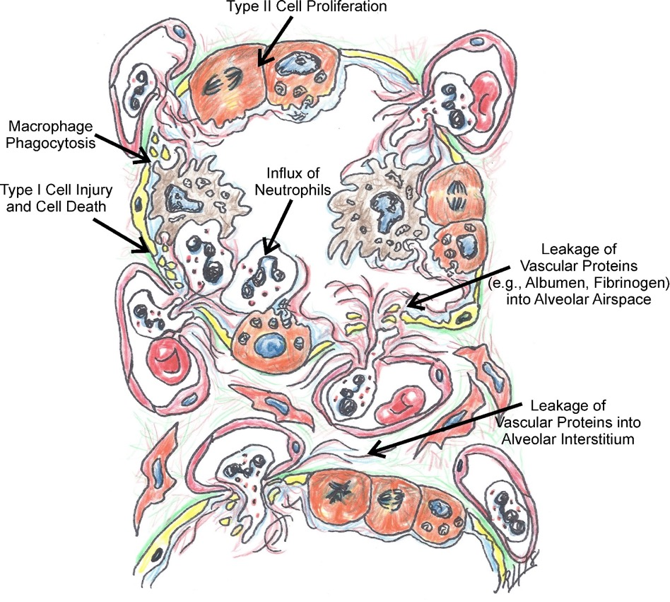
Acute Alveolar Injury, Inflammation (alveolitis) and Repair
Drawing by Jack Harkema
Light photomicrograph by Jack Harkema

Slide 4
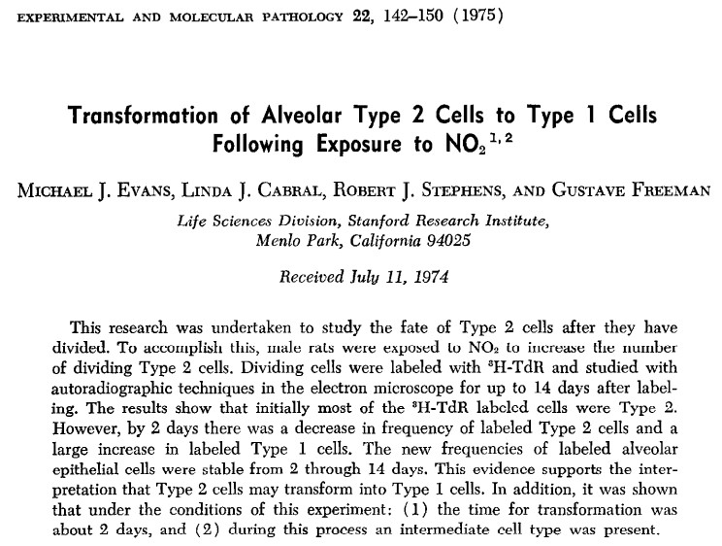
Alveolar Epithelial Injury and Repair Mechanisms (Evans, 1975)

Slide 5
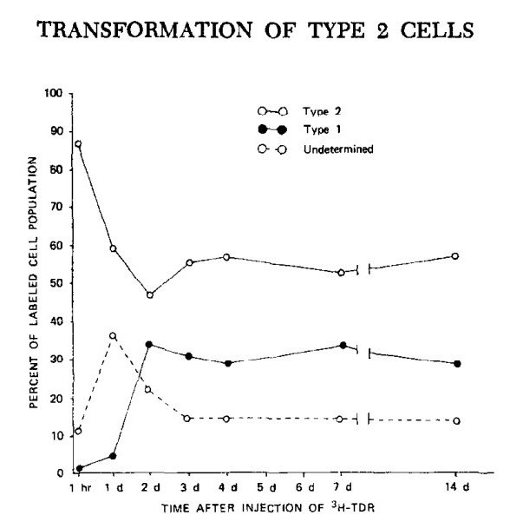
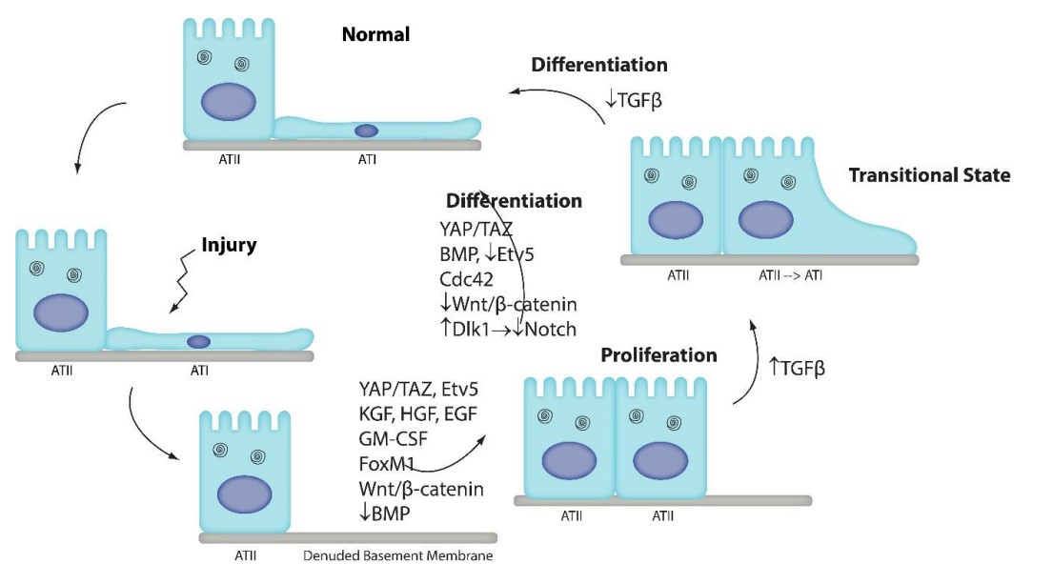
Alveolar Epithelial Injury/Repair Mechanisms (Evans, 1975; Zemans, 2020)
Evans MJ et al. Exp Mol Pathol 22:142, 1975; Aspal M & Zemans RL. Int J Mol Sci 21:3188, 2020

Slide 6
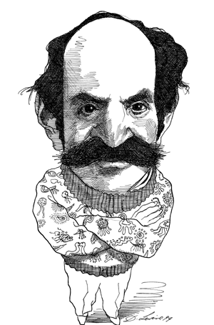
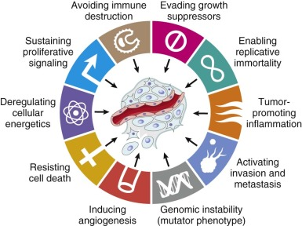
Molecular and Cellular Hallmarks of Cancer
From Robbins and Cotran: Pathologic Basis of Disease, 9th edition, 2015
(Adapted from Hanahan D, Weinberg RA. Hallmarks of cancer: the next generation. Cell 2011; 144:646.)

Slide 7
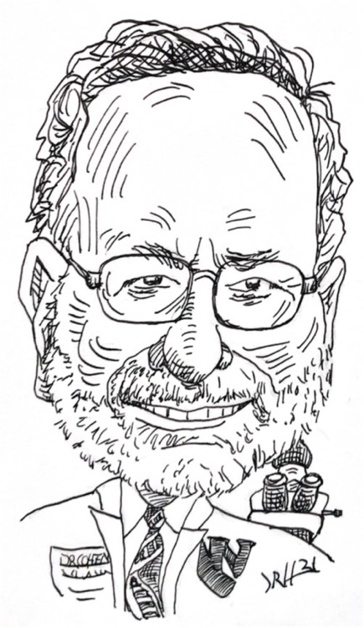
Basic understanding of chemical carcinogenicity
Cancer is due to mistakes occurring in the DNA (usually in somatic cells but can be inherited through germ cells).
More than one mistake in DNA is necessary
All of the mistakes need to accumulate in a single cell (clonal origin of cancer)
The cell population at risk are the tissue pluripotential (stem) cells.
Every time DNA replicates, permanent mistakes could occur
Carcinogenesis is a stochastic process
Two fundamental ways to increase the risk for cancer:
Damage DNA directly
Increase the number of stem cell replications
Cohen SM & Ellwen LB, Cancer Research 51, 6493-6505, 1991; Cohen SM et al. Reg Toxicol Pharmacol 103: 100-105, 2019

Slide 8
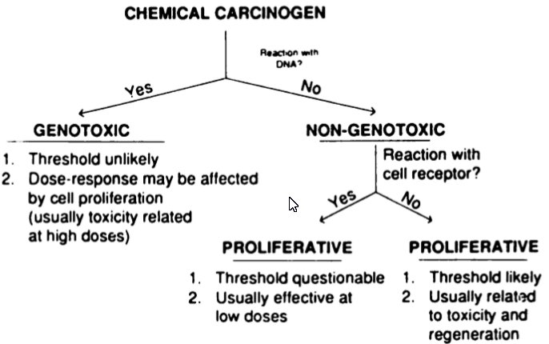
Classification of Chemical Carcinogens
(Reacts with DNA)
(No Reaction with DNA)
Cohen SM & Ellwen LB, Cancer Research 51, 6493-6505, 1991; Cohen SM et al. Reg Toxicol Pharmacol 103: 100-105, 2019

Slide 9
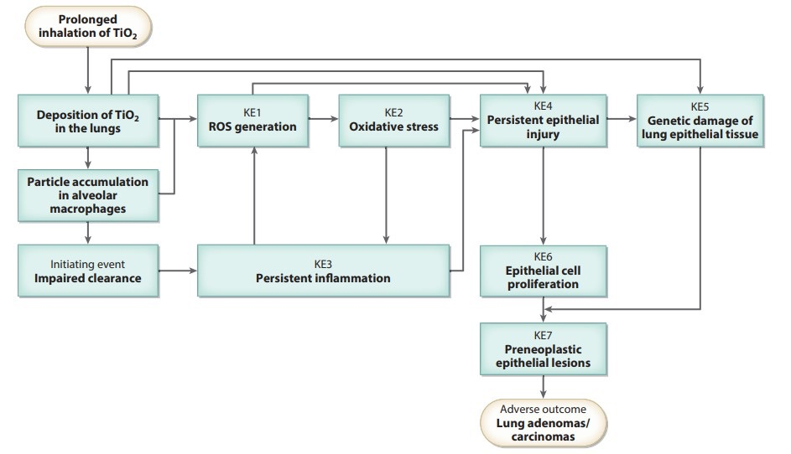
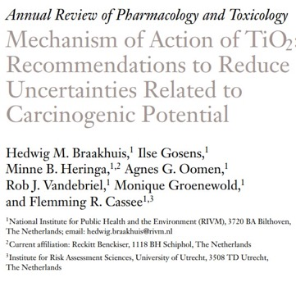
Proposed Adverse Outcome Pathway for Poorly Soluble, Low Toxicity Particle-induced Carcinogenicity in the Lung
Braakhuis H et al. Ann Review Pharmacol Toxicol, 61:203-223, 2021

Slide 10
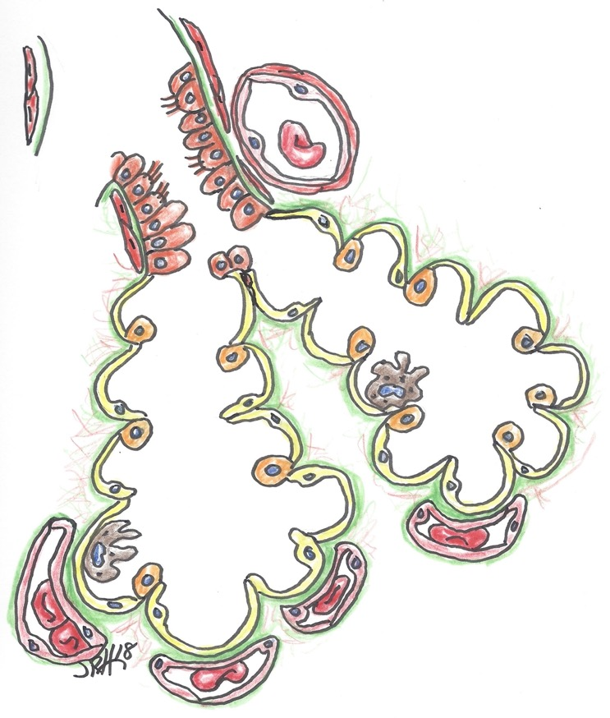
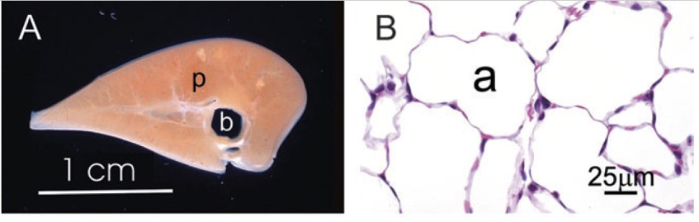
Normal rat lung (centriacinar region)
Bronchiolar epithelium
Pulmonary artery/arteriole
Type 1 alveolar epithelial cell
Type 2 alveolar epithelial cell
Alveolar septal capillaries
Alveolar macrophage (resident macrophage)
Elder A et al. Toxicol Sci 88:614-629, 2005

Slide 11
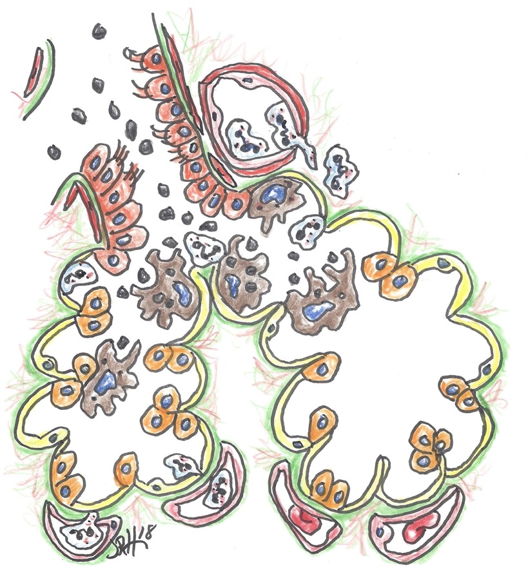
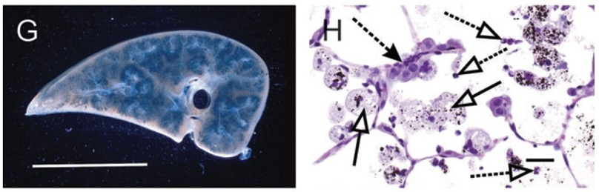
3 months of particle exposure
Inhaled particles
Neutrophilic inflammation (type 1 inflammatory/immune response)
Type 2 alveolar epithelial cell proliferation/hyperplasia
Macrophage/Monocyte accumulation/activation
Neutrophilic inflammation; type 1 immune/inflammatory response
A
B
Elder A et al. Toxicol Sci 88:614-629, 2005

Slide 12
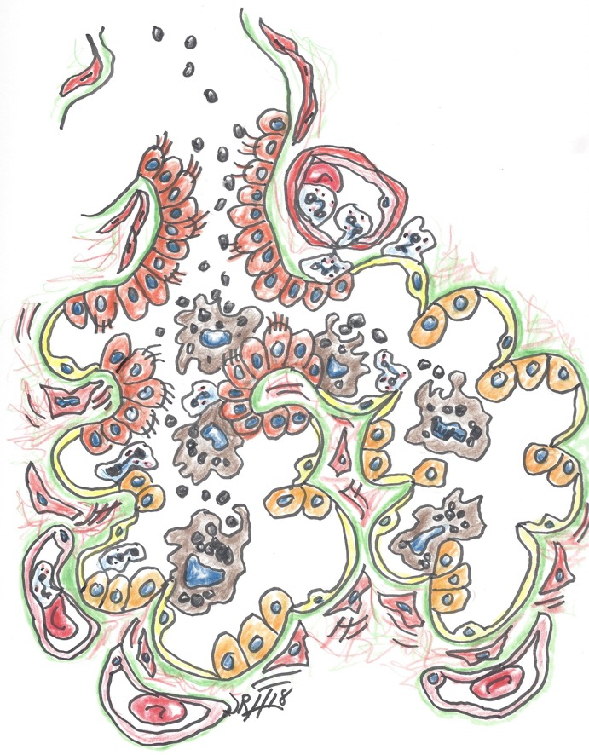
12 months of particle exposure
Bronchiolar epithelial cell proliferation/hyperplasia
Hyperplasia/respiratory metaplasia of alveolar type 2 epithelial cells
Early interstitial fibroblast proliferation and activation (collagen deposition)
Neutrophilic inflammation
Macrophage/Monocyte accumulation/activation

Slide 13
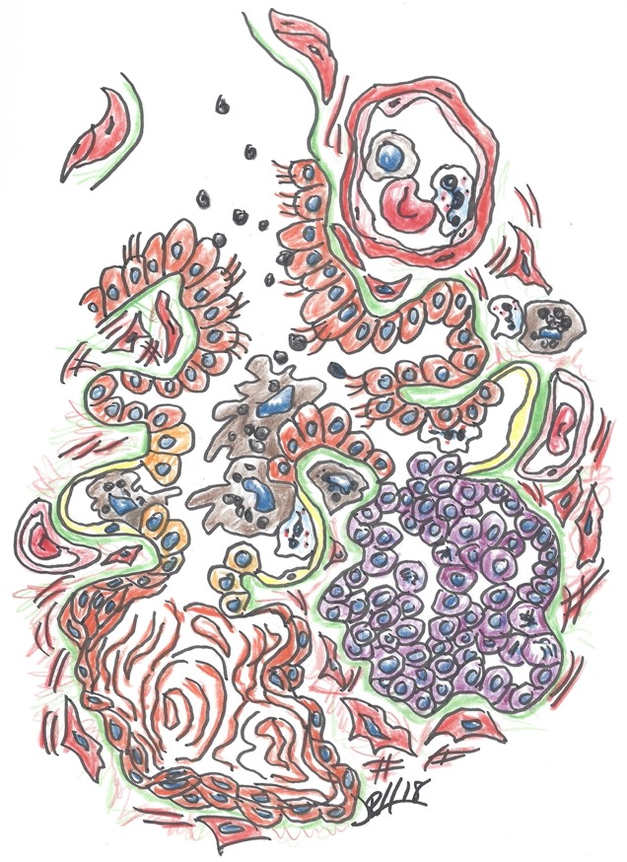
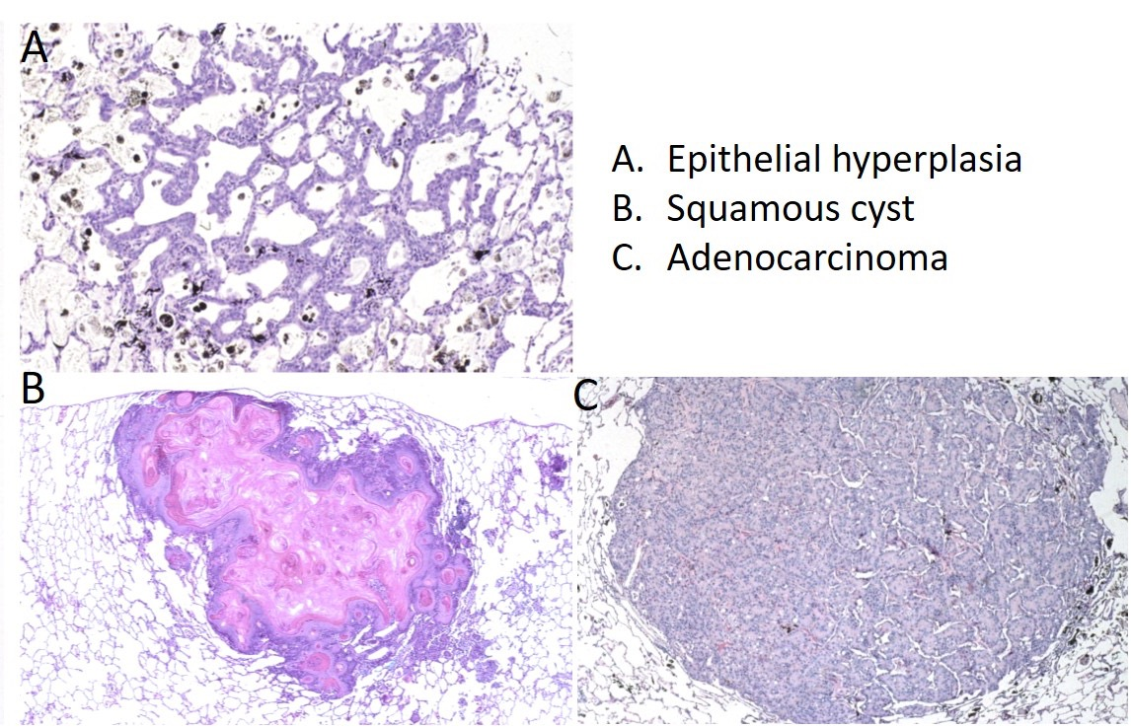
24 months of particle exposure

Slide 14
Short-term Bioassays for Chemical Carcinogenesis
Standard process for evaluating substances for carcinogenic activity is to perform a dose range finding study, usually 90 days, in the test species, followed by a two-year bioassay.
Now short-term screening assays focus on mode of action and human relevance.
Ultimately what is needed is a determination as to whether the inhaled agent/particle poses a cancer risk to humans.
Not an investigation to determine if a chemical poses a cancer hazard in rats or mice.
Cohen SM et al. Reg Toxicol Pharmacol 103: 100-105, 2019

Slide 15
Proposed Protocol: Short-term Bioassay for
Predicting Potential for PSLTP-induced Lung Cancer
Inhalation study with evaluations at 1, 4 and 13 weeks
Postexposure evaluation(s) for sustained proliferation
Microscopic evaluation for cell proliferation: histopathologic examination for alveolar epithelial hyperplasia and immunohistochemistry for DNA synthesis (Ki67; BrdU; PCNA)
Morphometric analyses for quantitative pathology (labelling index using digital image analysis)
Detect cell proliferation then develop adverse outcome pathway and evaluate human relevance
  Transcriptomic analyses: RT-PCR; Bulk tissue RNA sequencing
  Additional analyses such as single cell RNA sequencing, organoids, or in situ hybridization (RNAscope).

Slide 16
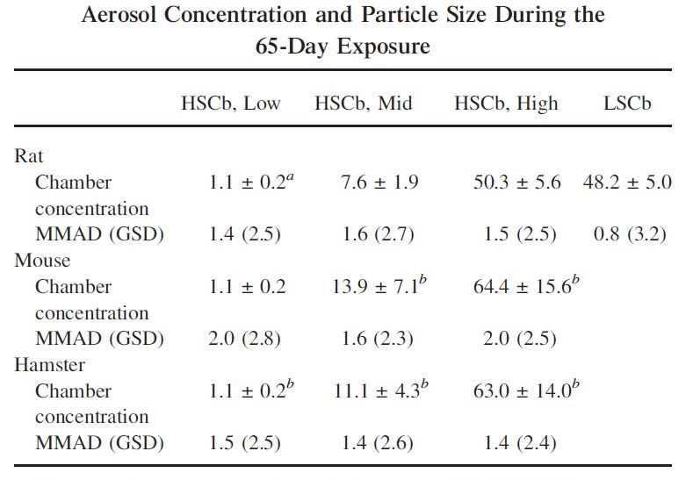
13-wk Carbon Black Inhalation Study: Animal Species and Exposures
Elder A et al. Toxicol Sci 88:614-629, 2005

Slide 17
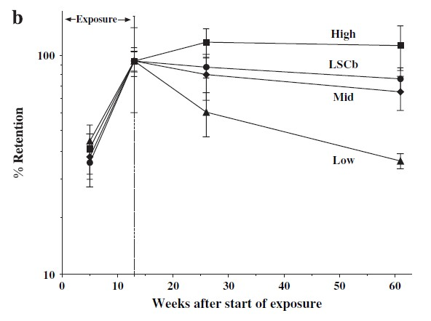
13wk Carbon Black Inhalation Study: CB Lung Retention
Elder A et al. Toxicol Sci 88:614-629, 2005

Slide 18
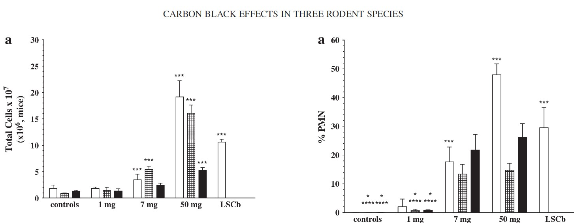
13wk Carbon Black Inhalation Study: Inflammatory Cells in BALF
Rats (white bars), Mice (hatched bars), Hamsters (black bars)
A
B
Total Cells
Neutrophils
Elder A et al. Toxicol Sci 88:614-629, 2005

Slide 19
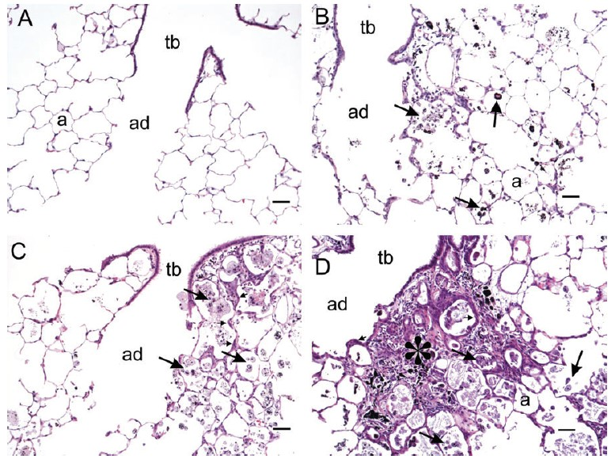
13wk Carbon Black Inhalation Study: High Dose HSCB Histopathology
Air Control
End of Exposure
3-month
Postexposure
11-month
Postexposure
Elder A et al. Toxicol Sci 88:614-629, 2005

Slide 20
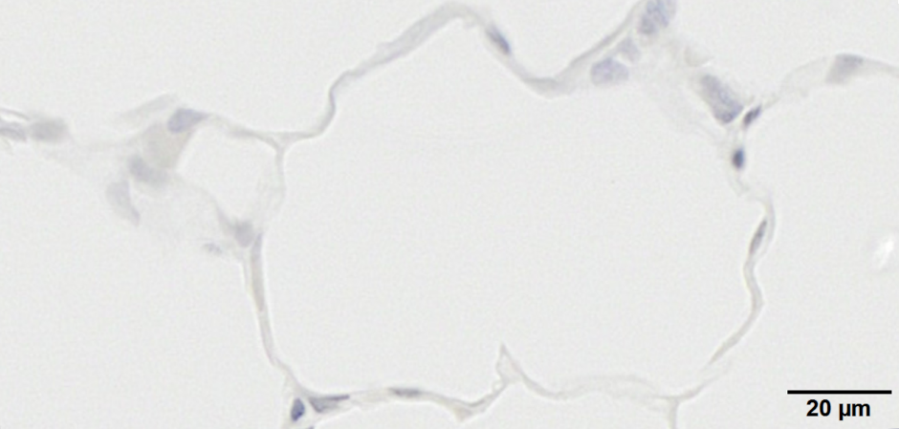
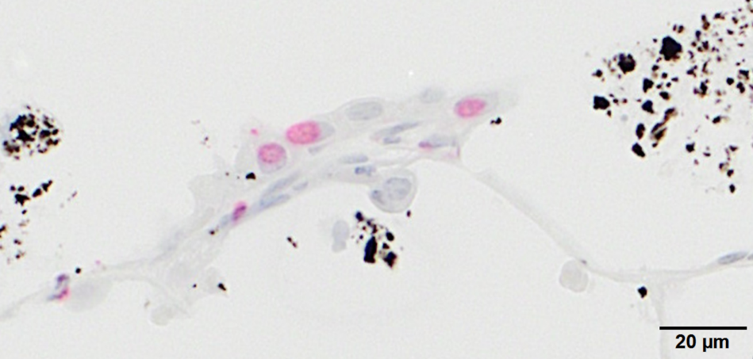
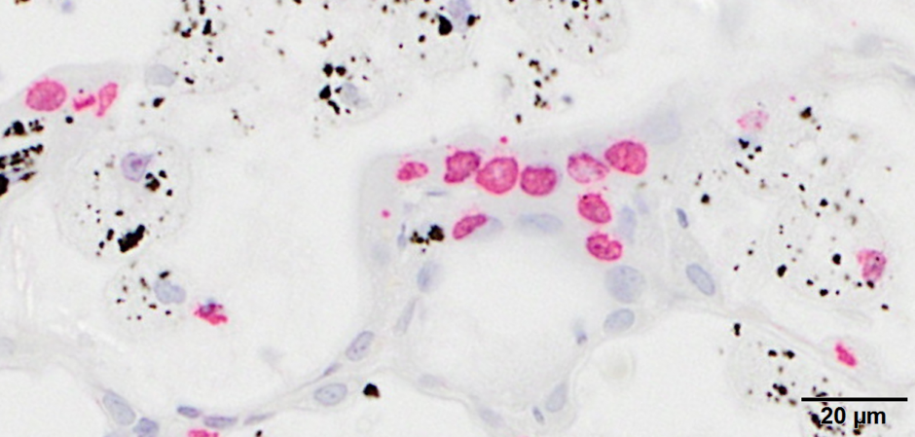
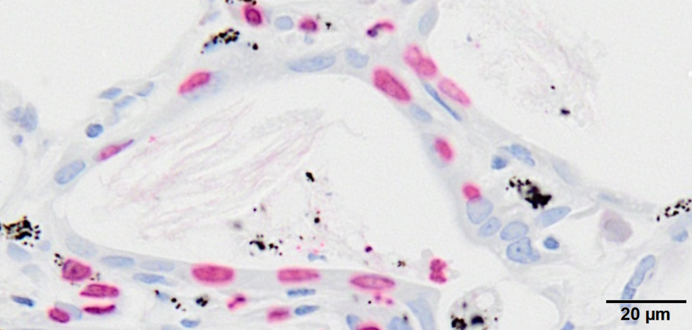
HSCB-induced AT2 Cell Proliferation (BrdU, IHC)
Control
End of exposure
3 mo postexposure
11 mo postexposure

Slide 21
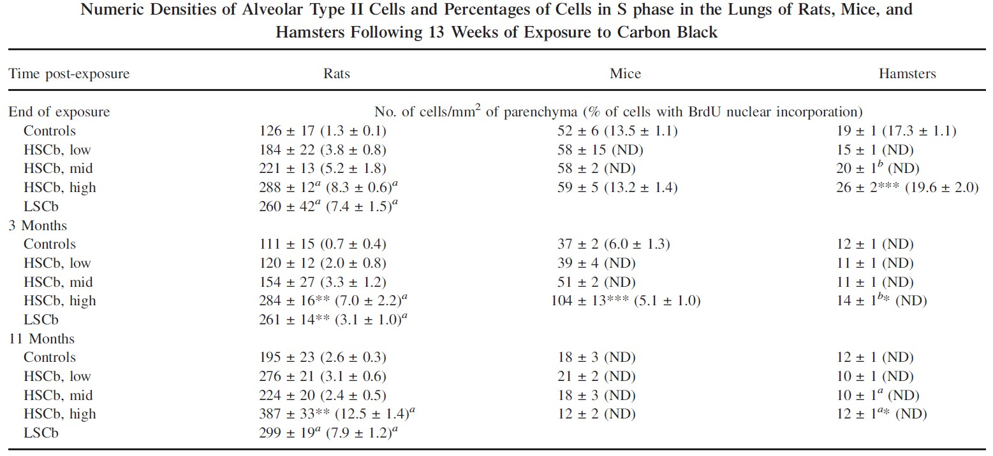
13wk Carbon Black Inhalation Study: AT2 Cell Proliferation

Slide 22
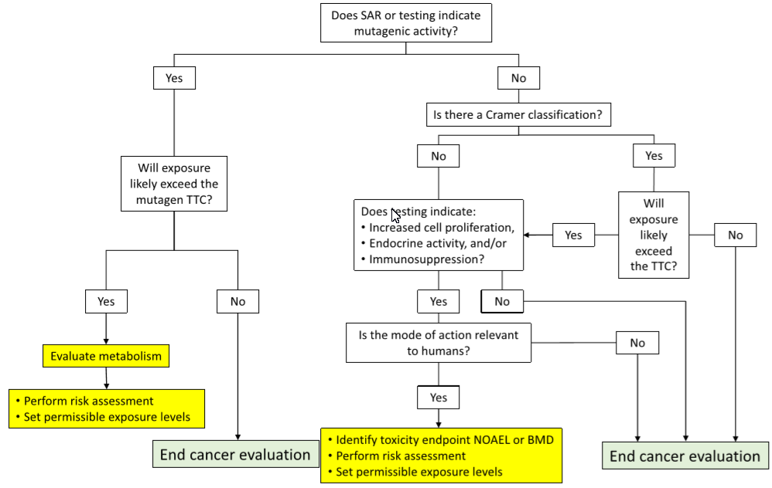
Suggested Carcinogenicity Assessment Process
1, 4, 13 wk exposure
Histopathology
Ki67, PCNA, BrdU
Cohen SM et al. Reg Toxicol Pharmacol 103: 100-105, 2019

Slide 23
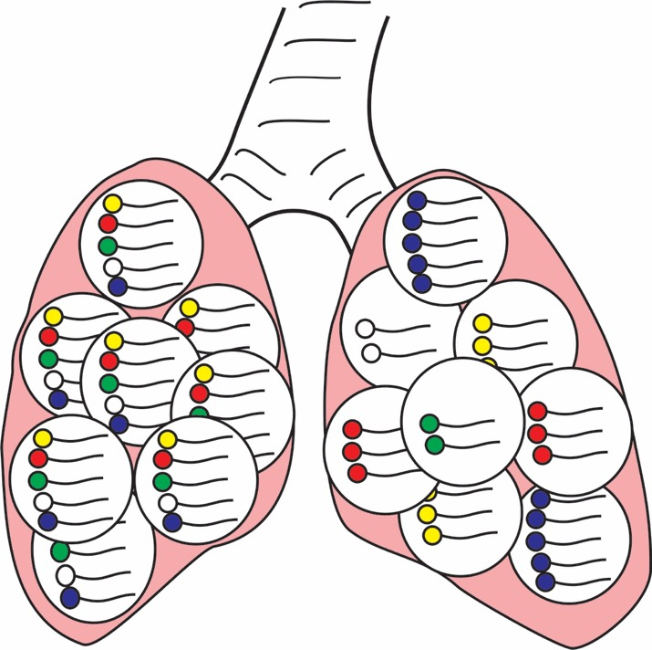
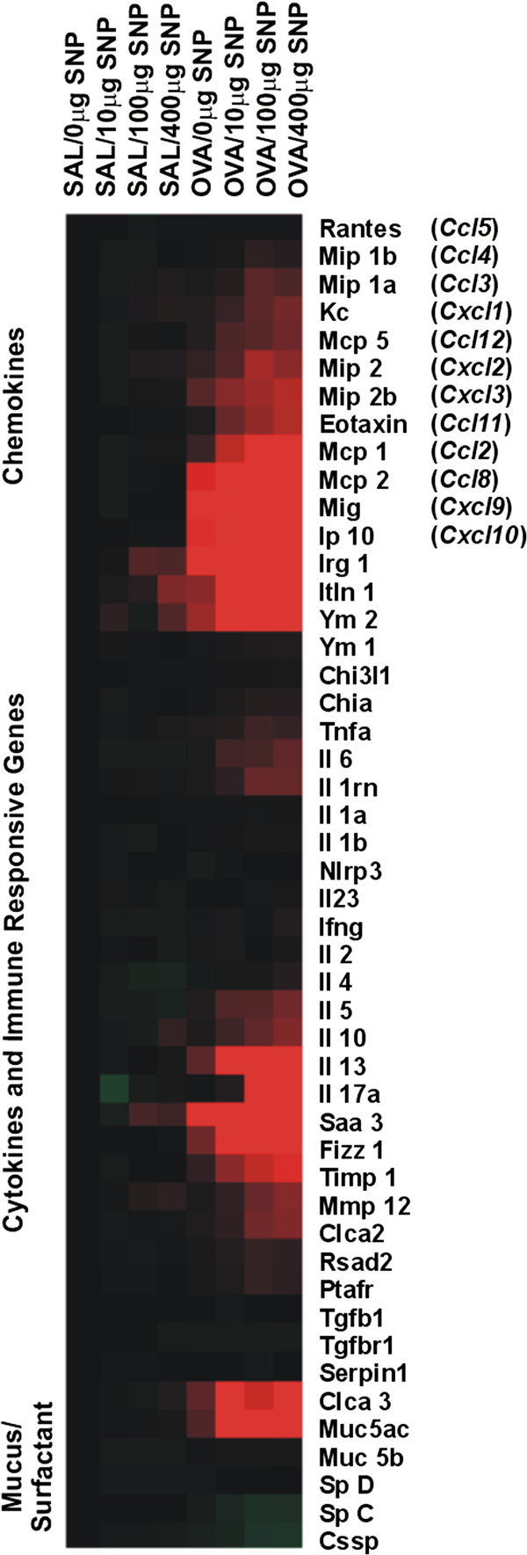
Single cell RNA sequencing – To better understand pathogenesis
Bulk Tissue
RNA Sequencing:
Averages gene
expression profile
Single-cell
RNA Sequencing:
Provides single cell
gene expression profiling
Illustrations by Jack Harkema
Modified from Chambers DC et al. (2019) Respirology 24, 29-36

Slide 24
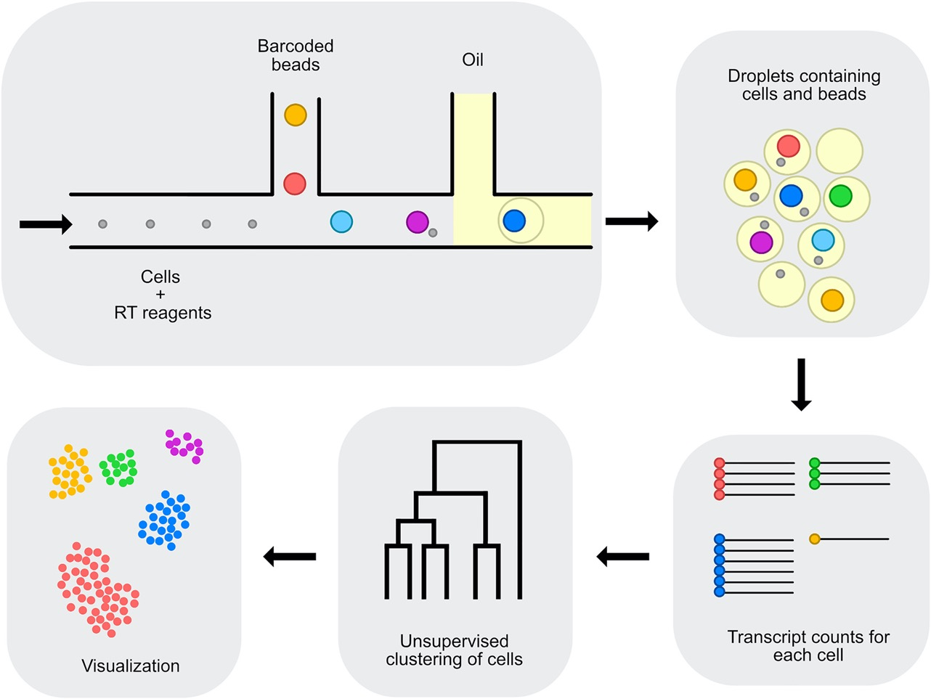
Single cell RNA sequencing procedure
Lung lobe/BALF
Isolated lung cells
Gene expression of
Endothelial cells
Epithelial cells
Fibroblasts
Macrophages
Monocytes
Modified from Chambers DC et al. (2019) Respirology 24, 29-36

Slide 25
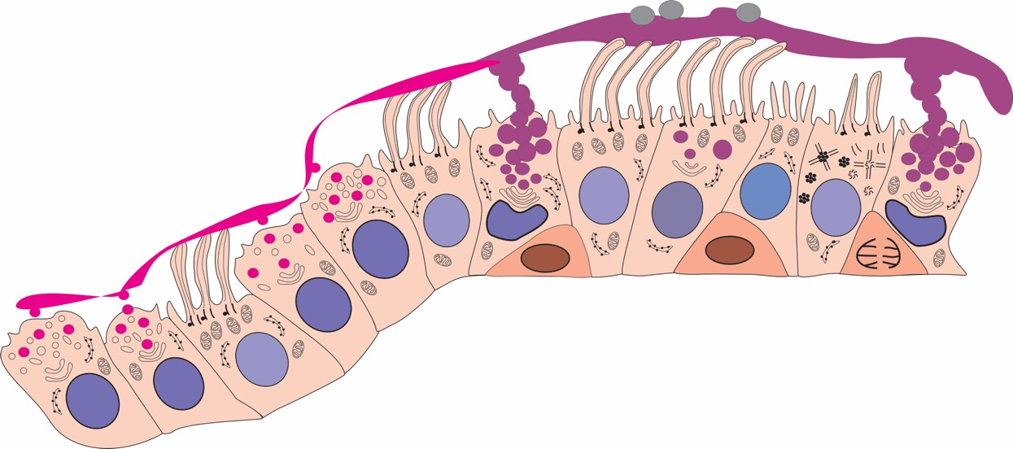
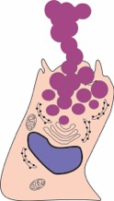
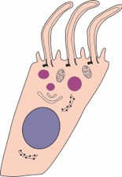
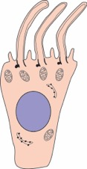
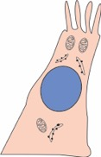


Unraveling Airway Cell Lineage by Single Cell RNA Seq
Airway Epithelial Cells
Basal
(KRT5⁺, TP63⁺)
Club
(SCGB1A1⁺)
Mucous
(MUC5AC⁺)
Mucous/Ciliated
(MUC5AC⁺, FOXJ1⁺)
Ciliated
(FOXJ1⁺)
Tuft
(ASCL2⁺, LRMP⁺)
Illustrations by Jack Harkema

Slide 26
Summary
Epithelial cell proliferation in toxicant-induced injury, repair, adaptation and cancer.
Pathogenesis of particle-induced proliferative and inflammatory responses (lesions) in rodent lungs (retrospective - subchronic Cb animal inhalation study)
Short-term (≤ 3 mo) bioassays for assessing the safety of long-term exposures to inhaled PSLTPs (predicting lung cancer potential)
Ancillary methods to better assess the respiratory toxicity/cancer potential of inhaled particles after short-term exposures

Slide 27
Acknowledgments
The Albert C. and Lois E. Dehn Endowed Chair in Veterinary Medicine (Pathobiology), College of Veterinary Medicine, Michigan State University
Kristen Nikula, Fletcher Hahn, Joe Mauderly, Roger McClellan, Lovelace Respiratory Research Institute
Alison Elder, Guenter Oberdӧrster, University of Rochester
Flemming Cassee, RIVM/Utrecht University, NL
Bart Westendorp and Gimano Amatngalim, Utrecht University, NL
Paul Borm and Kevin Driscoll

Slide 28
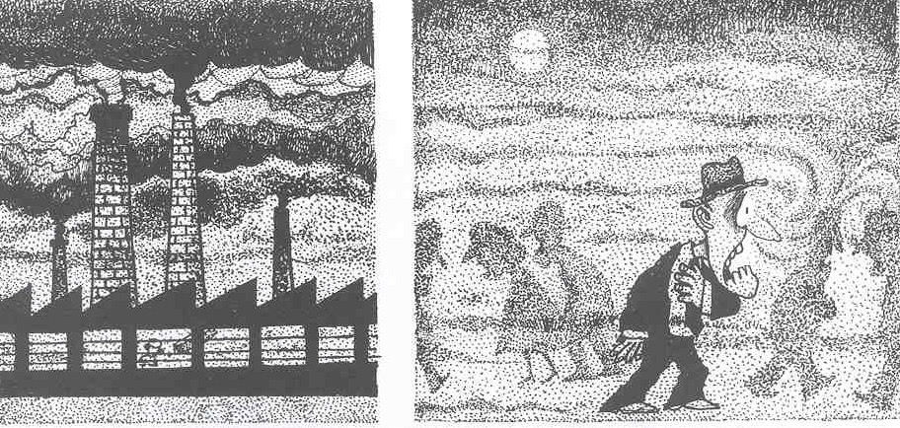
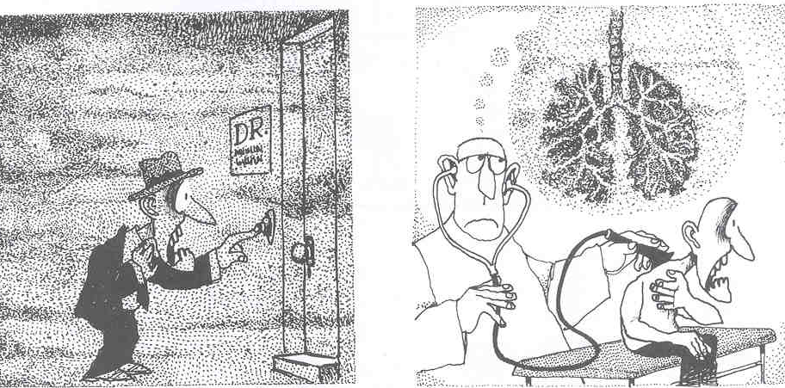
Thank You
Quino, 2008
Questions?

Slide 29
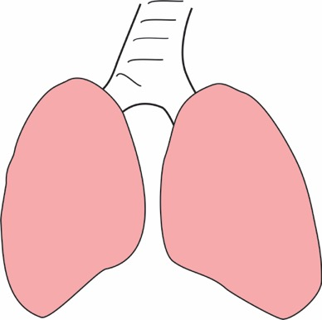
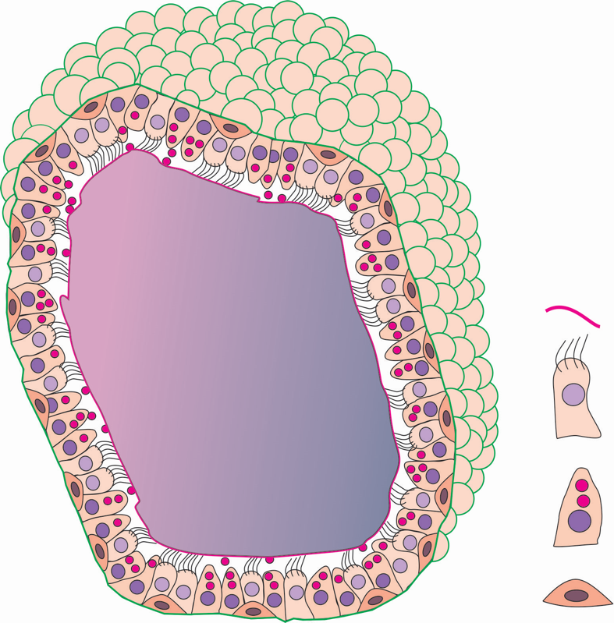
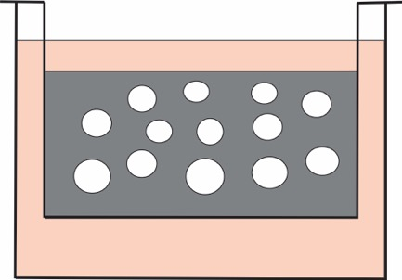
Human/animal organoids for disease modeling
Tracheobronchial
Airways
Analyses:
Histology
Morphometry
Gene Expression
Lung
Lobe
3D Cultures with
Matrigel
Collection of
Epithelial Cells
Lining
Fluid
Organoid from
Airway Epithelial
Stem Cells
Ciliated
Cells
Expand cells in
2D Cultures
Secretory
Cells
Basal
Cells
FAC/MAC
Sorting
Illustrations by Jack Harkema

Slide 30
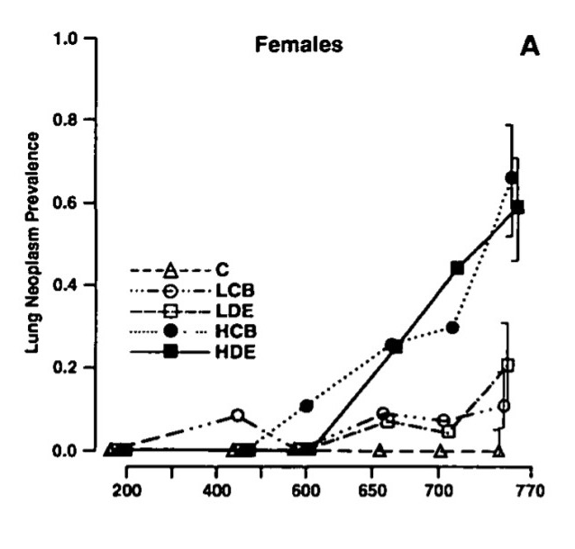
Prevalence of Lung Neoplasms in Female Rats Chronically Exposed to DE/CB
Study Design:
Male and Female F344 rats
Chronic DE or CB exposure, 5 days/wk at 0 mg/m3 (control), 2.5 mg/m3 (LDE, LCB) or 6.5 mg/m3 (HDE, HCB)
Examination after 3, 6, 12, 18 or 23 mo
Results:
No significant differences between carcinogenic potencies of CB and DE
Conclusion:
Organic fraction of DE might not play an important role in lung carcinogenicity of DE exposure in rats
Days from start of exposure
Nikula KJ et al. Fund Appl Toxicol 25, 80-94, 1995

