Slide 1
Pathology to be reconsidered? Limited to respiratory system,
Synthetic Amorphous Silica.
Klaus Weber¹, Nils Krueger²
¹AnaPath GmbH, Oberbuchsiten, Switzerland
² Evonik Operations GmbH, Smart Materials, Hanau-Wolfgang, Germany

Slide 2
    Synthetic Amorphous Silica: Highly Toxic?
‘…intestinal absorption of SAS was considered to be insignificant in animals and humans. Beside inflammatory reactions, toxicity was limited…
…data collected from industrial hygiene surveillance over
the last 50 years do not indicate any potential for skin
sensitization. Given the inherent physico-chemical
properties and ubiquitous nature of this class of
compounds, there is no structural alert to indicate a
sensitizing potential….’ (OECD, 2004).
Silica, amorphous, fumed (crystalline free) has a demonstrated lack of toxicity (EPA, 2002).
Many publications dealing with toxicity, but
2

Slide 3
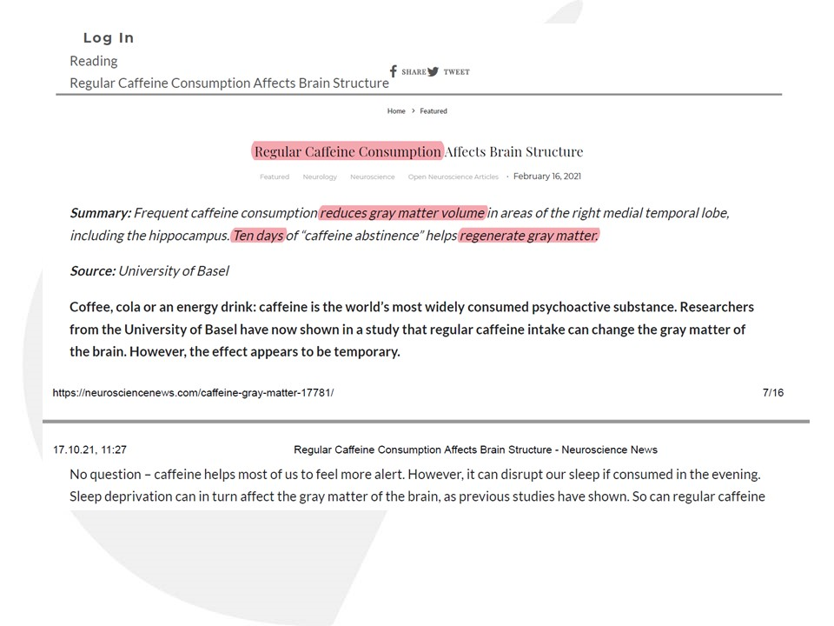
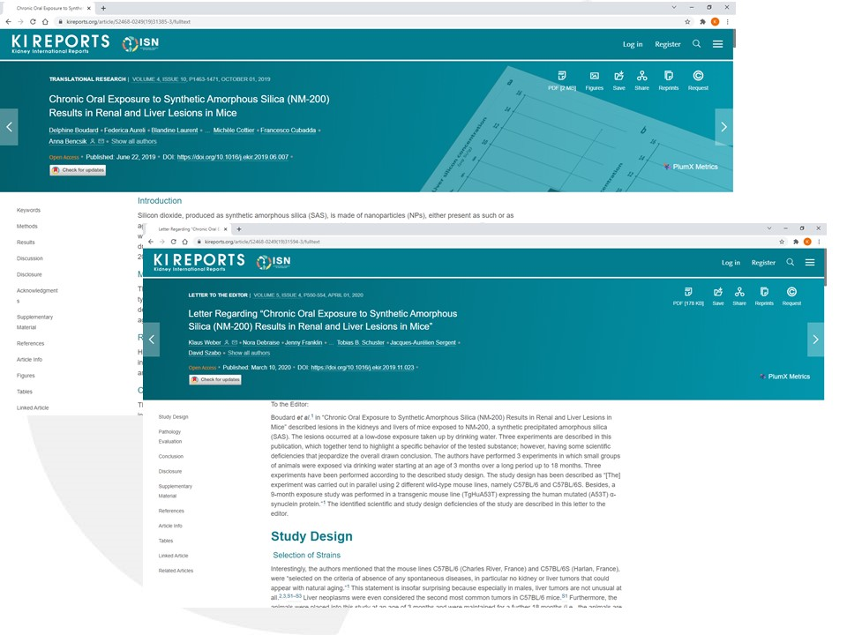

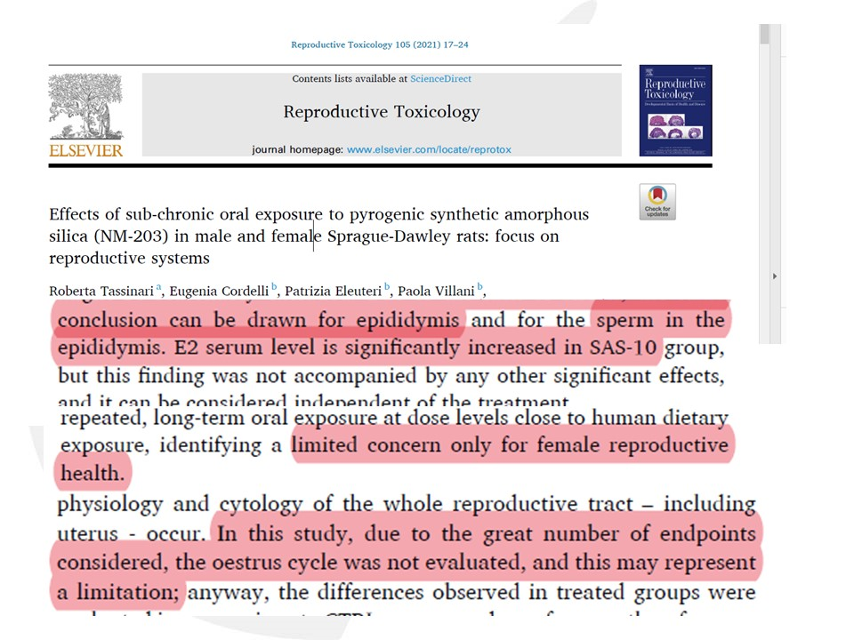

    Could it be…? Design, Financial, Positive, Political, Mis….
Correct study Designs?
Financials?
Need of ‘Positive’ Results?
Political Agenda?
Misnomers or Misinterpretations?
Missing Peer Review and/or Pathology Working Groups and/or Expert Panels?
3

Slide 4
    Examples: Lungs…
Reuzel, P.G., Bruijntjes, P., Feron, V.J. Woutersen, R.A. (1991).Subchronic Inhalation Toxicity of Amorphous Silicas and Quartz Dust in Rats. Food Chem Toxicol. 29: 341-354.
Fibrosis in all high doseanimals
Weber et al: Aerosols of synthetic amorphous silica do not induce fibrosis in lungs after inhalation: Pathology working group review of histopathological specimens from a subchronic 13-week inhalation toxicity study in rats. Toxicol Res App. 2018. 2: 1-17
Study and PWG Details in publication:
The treatment schedule was as follows:
Group A: Sham
Group D: Aerosil® 200,high dose (31 mg/m³)
Group E: Aerosil® R 974, high dose (34.7 mg/m³)
Group F: Sipernat® 22S, high dose (34.9 mg/m³)
Group G: Quartz (58.5 mg/m³).
Evaluation after 13 weeks (end of treatment) and recovery 13, 26, 39, and 52 weeks.
4

Slide 5
    Remark on ‘Inflammation’
part of the complex biological response of body tissues to harmful stimuli (pathogens, damaged cells, irritants)
protective response involving immune cells, blood vessels, and molecular mediators.
function is to eliminate the initial cause of cell injury, clear out necrotic cells and tissues damaged from the original insult and the inflammatory process
initiate tissue repair
redness, swelling, pain, heat, loss of function
blood flow is increased, and venules and capillaries dilate.
neutrophils adhere to the endothelial cells, and migrate into the connective tissue
monocytes enter the tissue and transform into macrophages, clean and secretion of cytokines (attractants)
to repair the damage, fibroblasts actively secrete pro-collagen, and some fibroblasts transform into myofibroblasts, that help to contract the connective tissue, and reduce the size of the scar.
5

Slide 6
Re-Evaluation and PWG
Re-Evaluation and Pathology Working Group (PWG)
Purpose: use of existing study material from TNO animal study to address question of `fibrosis´ (irreversible effect)
Results:
No `lung overload´ phenomenon (irreversible chronic persistent inflammation)
No substance induced fibrosis
SAS types show comparable effects – similar behavior in the lung
Physico-chem. properties of different SAS types (surface area, particle number etc.) cause some variations in the degree of inflammatory effects (NOAEL < 17 - < 46 mg/m³ / Reuzel et al. 1991)
In association with inflammation `Fibrogenesis´ (Richards et al. 1991) a reversible effect was observed in all SAS dose groups

Slide 7
Re-Evaluation and PWG
Overall conclusion:
Comparable toxicity of all tested SAS types, reversibility of effects, no substance induced fibrosis

Slide 8
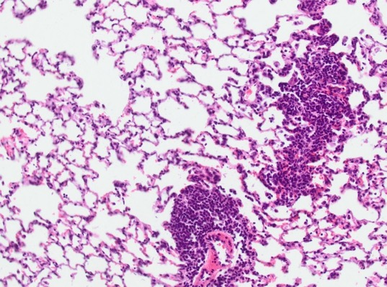
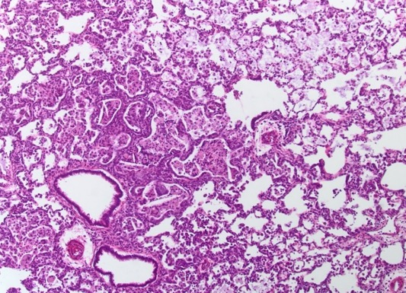
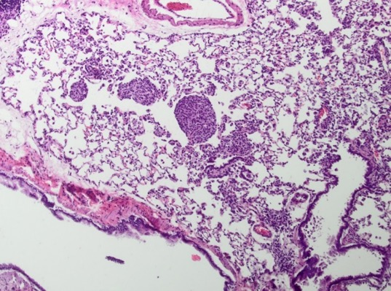
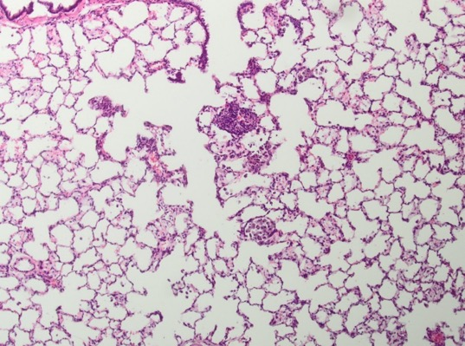
    End of Treatment: high doses cause inflammation
Control
High dose Aerosil® 200
Aerosil® R 974
Sipernat® 22S .

Slide 9
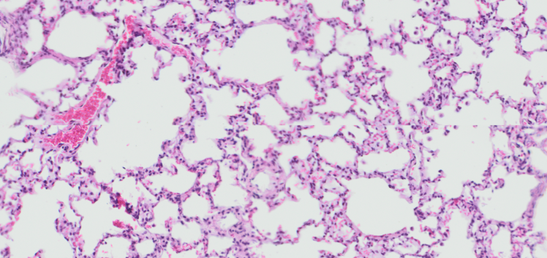
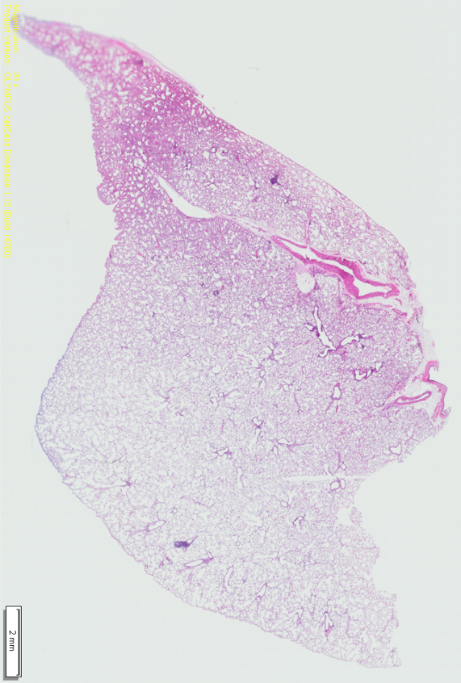
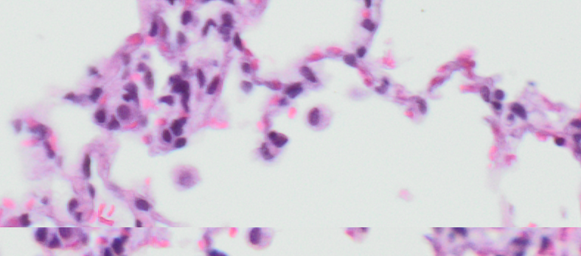
    52-Week Recovery. Example: Aerosil© 200, high dose, no fibrosis
52-week recovery. Aerosil 200,high dose,
D132. Normal lung. Focally single reactive alveolar macrophages.

Slide 10
RAC noted several issues with Weber et al.:
EC Number: 272-697-1.
the re-evaluation did not concern all animals, and only one lung section per animal:
Sections from 13- and 52-week recovery animals from both sexes are representative
All available sections per animal (up to 9 sections per lung) have been re-evaluated.
Re-evaluation report was Peer Reviewed
Peer Review forms part of the procedures of a PWG
The selection of single sections per animal as well as the selection of slides followed established PWG procedures, and hence this process was performed correctly.

Slide 11
RAC noted several issues with Weber et al.:
EC Number: 272-697-1.
…the almost 30-year old slides were de-cover-slipped, re-stained (with standard hematoxylin and eosin staining) and then cover-slipped again, whereby the de-coverslipping may potentially have damaged the original tissue samples;
known procedure described by many publications over decades, e.g., Cozma and Henwood (2019), Hinton et al. (2019), Small and Schultz (1943), Vicory et al. (2015).
members of PWG are internationally recognized experts, e.g. for general toxicologic pathology and specially, for inhalation pathology with 35 to 45 years of professional experience
You cannot remove fibrosis from septa! It stays there even there is an artefactual damage.
A collective of such experienced individuals would not be able to consider damage? Do we need pathologists at all?

Slide 12
RAC noted issues…
…In this re-evaluation Weber et al. concluded that only single incidences of minimal focal fibrosis were observed, without relation to the concentration, and a slight increase in fibrogenesis at the high dose males (2/10). There was also an increase in inflammation indicators, comparable with the other effects noted by Reuzel et al. (1991).
‘….PWG confirmed the absence of an induced fibrosis in this study. Some minor differences in inflammatory parameters were established (namely increased incidences of alveolar macrophages after 52 weeks)…
Based on these findings, no differences could be established between control group and the treated animals. Fibrogenesis and/or minimal focal
fibrosis were diagnosed in single animals in all groups. Similar level of
these findings were equally noted in untreated animals. In contrast, slight
to moderate fibrosis was diagnosed in all quartz-treated animals.

Slide 13
…Fibrogenesis, which is a reversible process, is proposed to be the main finding in the Weber et al. (2018) re-evaluation study instead of fibrosis, along with extensive local inflammation in the lung…. eptal cellularity and the alveolar bronchiolisation originally reported in Reuzel et al. (1991) (not disputed by Weber et. al., 2018 in its re-evaluation)…..
Groups | Group A | Group B | Group C | Group D | Group E | Group F | Group G
Finding/Groups
Total Animals/Sex Affected/Mean Severity | (10) M | (10) M | (10) M | (10) M | (10) M | (10) M | (10) M
Foreign material | 0 | 0 | 0 | 0 | 0 | 0 | 10/3.5 P<0.0001
Alveolar macrophages | 4/1.0 | 5/1.2 | 5/1.0 | 5/1.0 | 2/1.0 | 4/1.3 | 9/3.6 P=0.0286
Macrophage aggregations | 1/1.0 | 0 | 1/1.0 | 1/1.0 | 0 | 0 | 10/1.6 P=0.0001
Pneumocyte type II hyperplasia | 1/1.0 | 0 | 0 | 4/1.0 | 0 | 0 | 10/2.1 P=0.0001
Interstitial inflammation | 2/1.0 | 2/1.0 | 2/1.0 | 4/1.0 | 0 | 2/1.0 | 2/1.5
Granulomatous inflammation | 0 | 0 | 0 | 2/1.0 | 0 | 0 | 10/3.7 P<0.0001
Granulomas, alveolar- bronchiolar junctions | 0 | 0 | 0 | 0 | 0 | 0 | 10/3.3 P<0.0001
Fibrogenesis | 0 | 0 | 0 | 2/2.0 | 0 | 0 | 0
Fibrosis | 1/1.0 | 0 | 1/1.0 | 1/1.0 | 0 | 0 | 10/2.6 P=0.0001
Notes:
1x fbrosis in a control animal

Slide 14
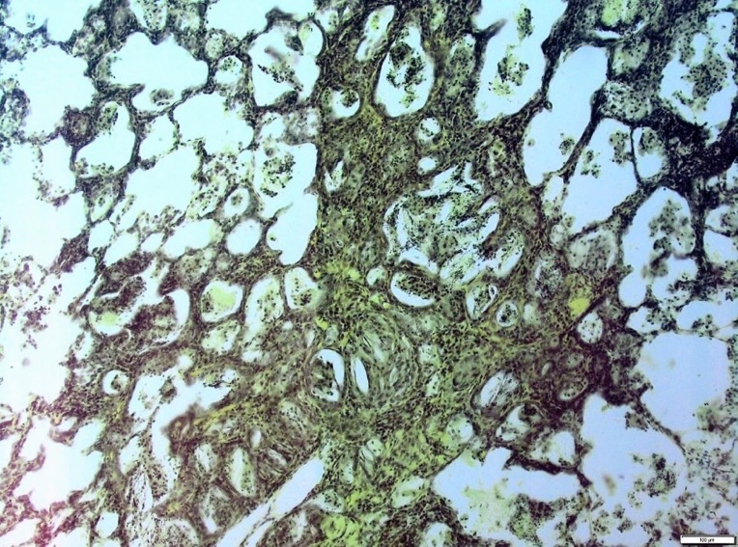
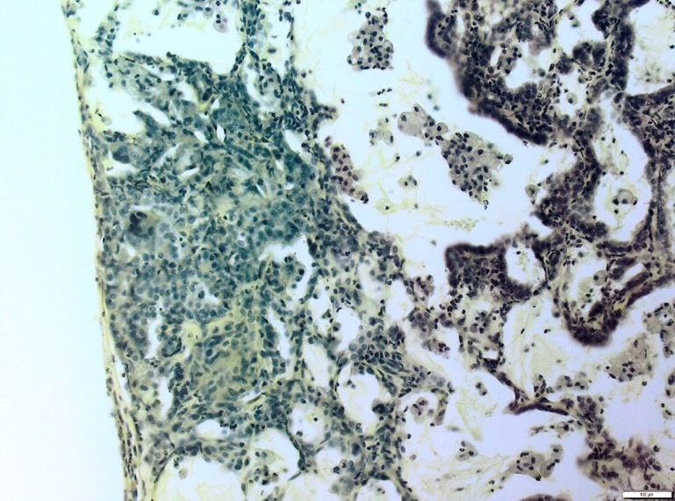
Nevertheless, the increase of lung collagen content (the specific Van Gieson stain was not used in the re-evaluation nor was OH-proline was measured)…..
Original slide set contained sections stained by Weigert van Gieson stain. staining technique is a combined trichrome stain for collagen and elastic fibers.
Misleading, since every alveolus is surrounded by reticulin fibers) and would stain positive.
However, no connective tissue at all was stained, only nuclei

Slide 15
New Study: Agreed with ECHA
(RAC Opinion EC Number: 272-697-1:
…the claimed recovery pertains to unusually long recovery periods for a 13-week rat study (13-52 weeks, as compared to 4 weeks as recommended in the OECD test guideline)…’)
2 test item aerosols SAS
inhalation at concentrations of 0.5, 1.0, 2.5, or 5.0 mg/m³ SAS 1 and SAS2 Control: air only
Daily for 13 weeks and recovery periods of 13, 26, and 52 weeks
Results:
interstitial inflammation, granulomas at junctions, changes in the BALT, increased incidence of fibrogenesis causes LOAEC at 2.5 mg/m³ after 52 weeks recovery
NOAEC for SAS 1 in lymph nodes was established at 5.0 mg/m³.
fibrogenesis and fibrosis in lymph nodes for SAS 2: no NOAEC
Same pathologist was member of previous PWG. Can be considered realistic

Slide 16
Anatomical and Physiological Considerations
Selected

Slide 17
    Differences in nose: rodents vs primates
Rats are nose breathers
1 nasoturbinate
1 maxilloturbinate
6 ethmoturbinates with dorsal and ventral scrolls
Harkema JR, Morgan KT. Normal Morphology of the Nasal Passages in Laboratory Rodents
Young JT (1981). Histopathologic examination of the rat nasal cavity. Fundam. Appl. Toxicol. 1: 309-312.

Slide 18
    Differences in larynx rodents vs primates
No ventral pouch exist in human.
Ventral pouch is a major site of deposition
Metaplasia at epithelium above underlaying ventral gland is usually recovering in rats but not in human (preneoplastic)
Weber K; Germann, PG.; Iwata, H.; Hardisty, J.; Kaufmann, W.; Rosenbruch, M.: Lesions in the Larynx of Wistar RccHanTM: WIST Rats. J Toxicol Pathol, 22: 228–246 (2009).

Slide 19
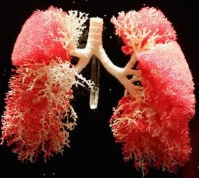
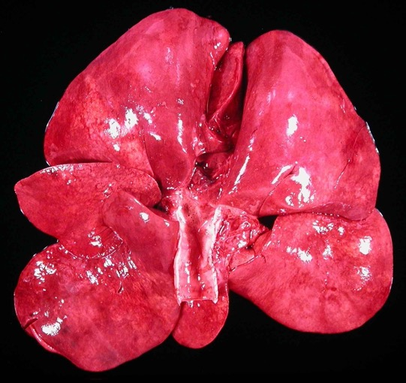
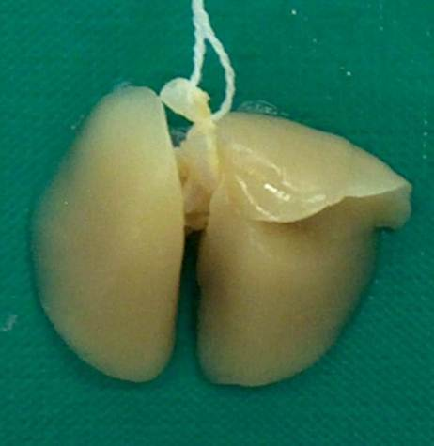
Lung: Differences between species
Left Lung Divided: human, macaque, rabbit, guinea, dog
cranial lobe with cranial and caudal part
caudal lobe
Left Lung Undivided:
rat, hamster, mouse, gerbil

Slide 20
    Bronchial ramification - Cause of Different
    Ventilation
Miller FJ, Mercer RR, Crapo JD. ower Respiratory Tract Structure of Laboratory Animals and Humans: Dosimetry Implications. Aerosol Science and Technology, 18:3, 257-271,

Slide 21
    Volume Portion of Airway Cell Types
Miller FJ, Mercer RR, Crapo JD. ower Respiratory Tract Structure of Laboratory Animals and Humans: Dosimetry Implications. Aerosol Science and Technology, 18:3, 257-271,
Implication!!! Metabolism.
E.g. Clara cells: CYP 2f2 in mice
Strupp C, Banas DA, Cohen SM, Gordon E, Jaeger M, Weber K (2011). Analysis of the Human Relevance of Mouse Lung Tumors Following Chronic Dietary Exposure to Fluensulfone According to the IPCS Mode of Action Framework. IJT (submitted)

Slide 22
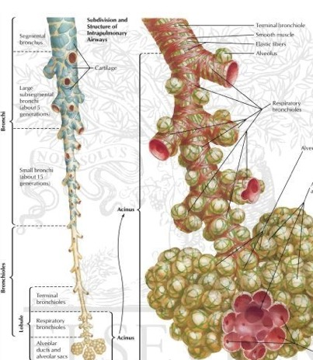
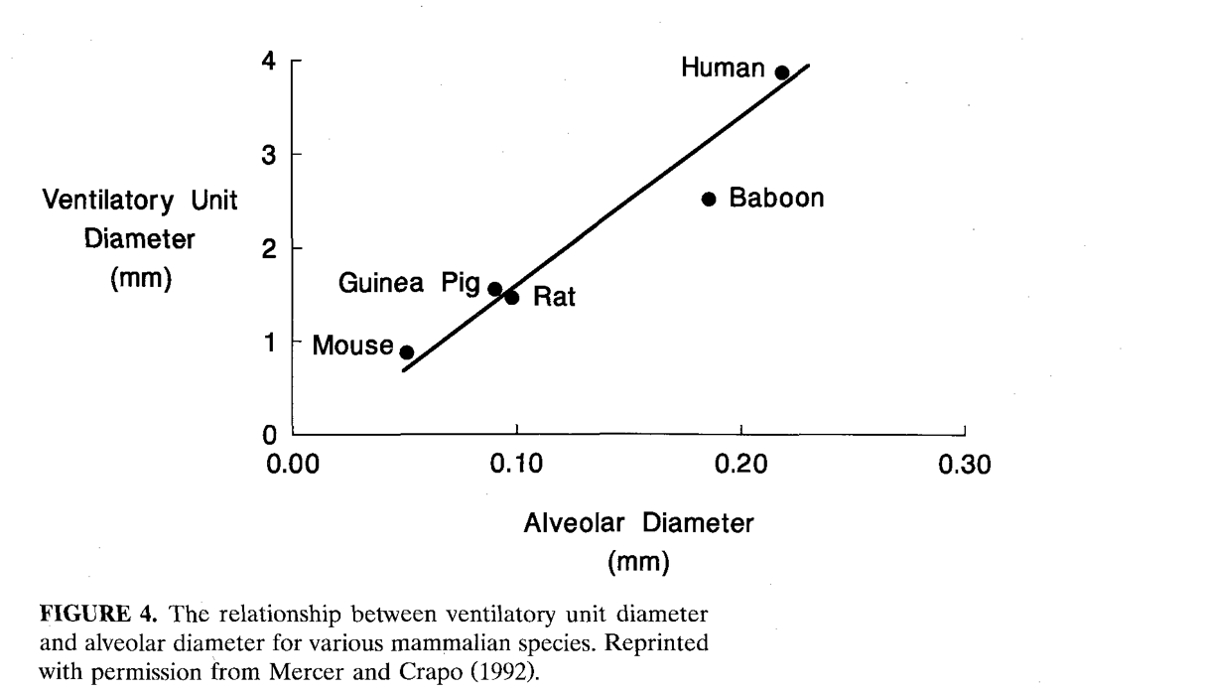
    Ventilatory unit diameter in different species
Miller FJ, Mercer RR, Crapo JD. ower Respiratory Tract Structure of Laboratory Animals and Humans: Dosimetry Implications. Aerosol Science and Technology, 18:3, 257-271,

Slide 23
    Overload!
Yang, et al.: Pulmonary Toxicity in Rats Caused by Exposure to Intratracheal Instillation of SiO2 Nanoparticles, Biomed Env Sci. 2017, 264-279
Design:
1 mL of saline containing 6.25, 12.5, and 25.0 mg of SNs or 25.0 mg of microscale SiO2 particles suspensions for 30 d to Wistar rats (males)
Body weight: 180-220 g
Results:
…lung inflammation, damaged alveoli, granuloma nodules formation, and collagen metabolized perturbation…increase lipid peroxidation and high expression of cytokines
Relevance:
None!
Mean Lung Weight in own control data: 1.194±0.118 g
The equivalent load of lungs is of a ratio foreign material: mean organ weight = 1:6 to 1:1.6 dose equivalent to ca. 0.2 g/lung up to 0.75 g/lung within 30 days
23

Slide 24
    Expected
Park et al.: A single instillation of amorphous silica nanoparticles induced inflammatory responses and tissue damage until day 28 after exposure. J Health Sci. 2011, 60-61
Design
Aerosil® 200: 1 mg/kg, single intratracheal instillation, per ICR mouse
Number of animals per time point 4(???)
body weight 25±1 g equivalent to ca. 0.025 mg/lung
Control Data: lung weight 0.215 g
ratio foreign material:lung approx. 1:8000
Results
weight gain decreased significantly on day 1 and 7 after instillation.
IL-1, IL-6, TNF-α, TGF)-β increased
distribution of Tc, NK and NKT cells with G1 arrest increased
microgranulomatous changes on day 7 and 14
total of 331 genes were up-regulated more than 2x, and 128 genes were down-regulated more than 2x.
24

Slide 25
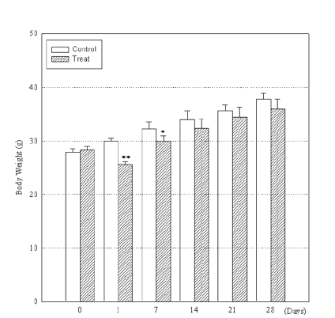
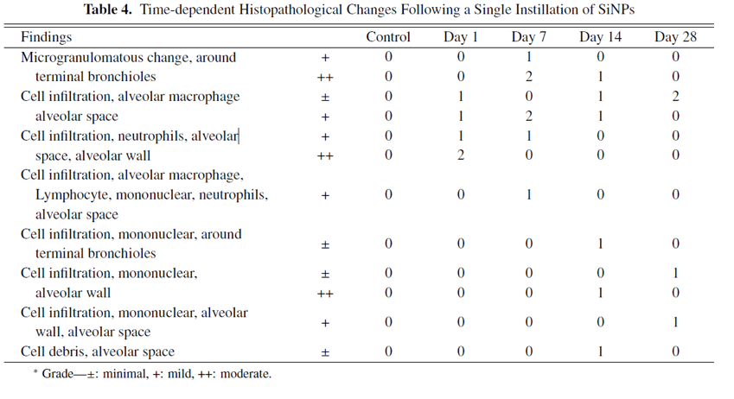
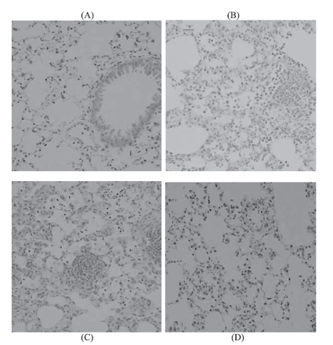
    Foreign bodies in lungs
Park et al.: A single instillation...
Relevance:
Yes for the model, foreign body reaction
Relevance for human: intratracheal?
Any foreign body causes reaction in lungs
25

