Slide 1
Applying Translational Science Approaches to Protect Workers Exposed to Nanomaterials
P.A. Schulte, R.J. Guerin, L. Hodson, T. Cunningham, V. Murashov
National Institute for Occupational Safety and Health
Centers for Disease Control and Prevention
Disclaimer: The findings and conclusions in this presentation are those of the authors and do not necessarily represent the official position of the National Institute for Occupational Safety and Health, Centers for Disease Control and Prevention. Total Worker Health® is a registered trademark of the US Department of Health and Human Services.

Slide 2
The occupational safety and health (OSH) field has historically focused on the etiologic end of the research-to-practice continuum rather than the dissemination, implementation and public health impact end.

Slide 3
Historic Focus of Occupational Safety and Health Field
Basic
Research
Implementation Impact

Slide 4
There has been a call to increase efforts to investigate factors that limit or enhance
Development
Transfer
Use
Of OSH risk factor and intervention information and technology
Thus ensuring that this knowledge leads to improvements in workers’ health

Slide 5
Translational Science
“…the application of scientific investigative approaches to study how the outputs of basic and applied research can be effectively translated into practice and have an impact.” (Schulte et al., 2011)
“…comprehensive applied research that strives to translate the available knowledge and make it useful.”
(Narayan et al., 2000)
“…research steps to take scientific discoveries ‘from the bench to the beside and back again.’” (Fort et al., 2017)

Slide 6
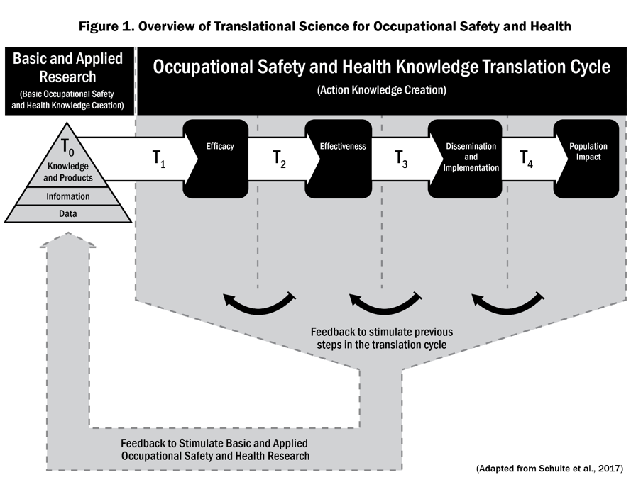

Slide 7
Translational science in OSH builds on
NIH model (2003) and interpretation by Khoury et al. (2004)
“Bench-to-bedside”
4 phases: T1-T4
Characterized by moving findings to a larger scale
Focuses on how best to make those transitions
Also builds on:
Westfall, Mold, & Fagnan (2007).
Public health model of Ogilvie et al. (2009)
Knowledge to Action (Graham et al. 2006; Wilson et al. 2011)
Knowledge Transfer and Exchange (Lavic et al. 2003; Van Eerd et al. 2011)
Application by Lucas et al. (2014)

Slide 8
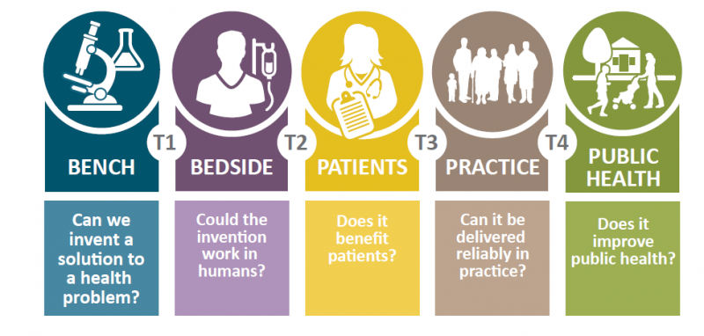
Translational Research Cycle

Slide 9
Translational Research is not:
r2p (research to practice)
Translation
Rather it is the study of these activities

Slide 10
Phase 1: Efficacy Research
Study of the efficacy of an intervention or information that could be used to protect workers.

Slide 11
Examples of interventions to address worker exposure to ENMs
Intervention | Example
Program | OECD Characterization
Practices | Occupational Exposure Limits
Principle | Consider ENM hazardous until proven otherwise
Procedures | Nanomaterial Exposure Assessment Technique
Products | Direct reading instrumentation
Policies | ISO/TC 229 Nanotechnologies voluntary standards, WHO guidelines on protecting workers from potential risks of manufactured nanomaterials.
Adapted from Brown et al., 2017

Slide 12
Phase 2: Effectiveness Research
Assess effectiveness of a new recommendation or intervention in real-world settings to develop generalizable knowledge

Slide 13
Phase 3: Dissemination and Implementation Research
Study the movement of evidence-based technology and interventions into well accepted OSH practice
Identify barriers and facilitators to implementation, dissemination
Engage key stakeholders (throughout all translational stages)
Focus on occupational health equity
Consider and characterize the multi-level context and environment
Identify implementation strategies and mechanisms of action
Notes:
Referred to as “how” an evidence-based program is implemented (Proctor, Powell, & McMillen, 2013), implementation strategies are the methods used to enhance program implementation outcomes (e.g., adoption, fidelity, and sustainability, see section 3.3 below) (Proctor et al., 2011).
Mechanisms of change/action describe the process by which an implementation strategy brings about specified implementation outcomes.
Implementation outcomes are key, intermediate outcomes that are critical for monitoring the successful implementation of evidence-based programs (NCI, 2019) (such as fidelity acceptability and cost). They are distinct from effectiveness outcomes and can be measured in the same study.

Slide 14
Implementation Science
Implementation Science is the study of factors that influence the full and effective use of innovations in practice. The goal is not to answer factual questions about what it is, but rather to determine what is required (National Implementation Research Network).

Slide 15
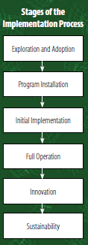
(Fixsen et al. 2005)

Slide 16
D&I Theories, Models and Framework (TMFs)
Tools to guide the development and evaluation of D&I studies
More than 150 have been identified
Commonly used ones:
Consolidated Framework for Implementation Research (CFIR; Damschroder et al., 2009),
RE-AIM (Reach, Effectiveness, Adoption, Implementation, Maintenance) framework (Glasgow et al., 1999; Glasgow et al., 2019)
EPIS (Exploration, Planning, Implementation, Sustainment) framework (Aarons et al., 2011)
Diffusion of Innovation theory (Rogers, 2003)
Theoretical Domains Framework (TDF) (Michie et al., 2005).

Slide 17
Study designs used in D&I research
Experimental (e.g., randomized controlled trial, cluster-randomized controlled trial, pragmatic trial, stepped wedge trial, dynamic wait-listed control trial)
Quasi-experimental (e.g., nonequivalent groups, pre-/post-, regression discontinuity, interrupted time series)
Nonexperimental or observational (including designs from epidemiology)
Mixed-methods (i.e., the collection and integration of qualitative and quantitative)
Qualitative methods (e.g., focus groups, semistructured interviews)
System Science approaches (e.g., system dynamics, agent-based modeling)
(Gila et al. 2018)

Slide 18
Phase 4: Population Impact Research
Investigate large-scale use of interventions and their impact

Slide 19
Three examples to assess for translational research in nanotechnology
NIOSH recommended exposure limits for Titanium Dioxide and Carbon Nanotubes/Nanofibers
WHO Guidelines On Protecting Workers from Potential Risks of Manufactured Nanomaterials
International Risk Governance Council (IRGC) White Paper on Nanotechnology Risk Governance

Slide 20
Example 1. NIOSH Recommended exposure limits for TiO₂ and CNT/CNF

Slide 22
Quantitative Risk Assessment in Developing Recommended Exposure Limits for Nanoparticles
Human
Recommended exposure limit
Rat
Technical feasibility of measurement and control
Dose-response model (particle surface area dose in lungs)
Working lifetime exposure concentration*
Estimated lung deposition fraction
Calculate lung tissue benchmark dose
Extrapolate
Equivalent tissue dose
(Adjust for species differences in lung surface area)
Assume equal response to equivalent dose
*Compare rat-based risk estimates with confidence intervals from human studies

Slide 23
Ultrafine (Nanoscale) TiO₂
Recommended Exposure Limit
0.3 mg/m³ (TWA for up to 10 hrs/day for a working lifetime)
Estimated to reduce risk of lung cancer below 1 in 1,000

Slide 24
Risk Assessment: Carbon Nanotubes
Used data from Ma-Hock (2009)
Wistar rats exposed by inhalation to 0.1, 0.5, 2.5 mg/m³ multiwall carbon nanotubes (6 hr/day, 5 days/wk, 15 wks)
Recommended Exposure Limit (REL) for respirable CNT/CNF 1 µg/m³ (as elemental carbon) as an 8-hr TWA.
Reduce risk of pulmonary fibrosis and acute pulmonary inflammation.

Slide 25
Translation Science
Example 1: Recommended Exposure Limits (TiO₂ & CNT/CNF)^{1,2}
T₀ | Basic Science | Ultrafine and fiber toxicity Specific studies of ENMs Quantitative risk assessment
T₁ | Efficacy | Sensitivity analysis of risk assessment Historical basis for OELs
T₂ | Effectiveness | No examples Extensive use
T₃ | Dissemination & Implementation | No examples Hypothetical questions
T₄ | Population Impact | Use of intermediate indicators (e.g., Iavicoli et al. 2020) Longitudinal studies Sustainability studies
NIOSH 2011
NIOSH 2013

Slide 26
Example 2. WHO Guidelines on Protecting Workers from Potential Risks of Manufactured Nanomaterials

Slide 27
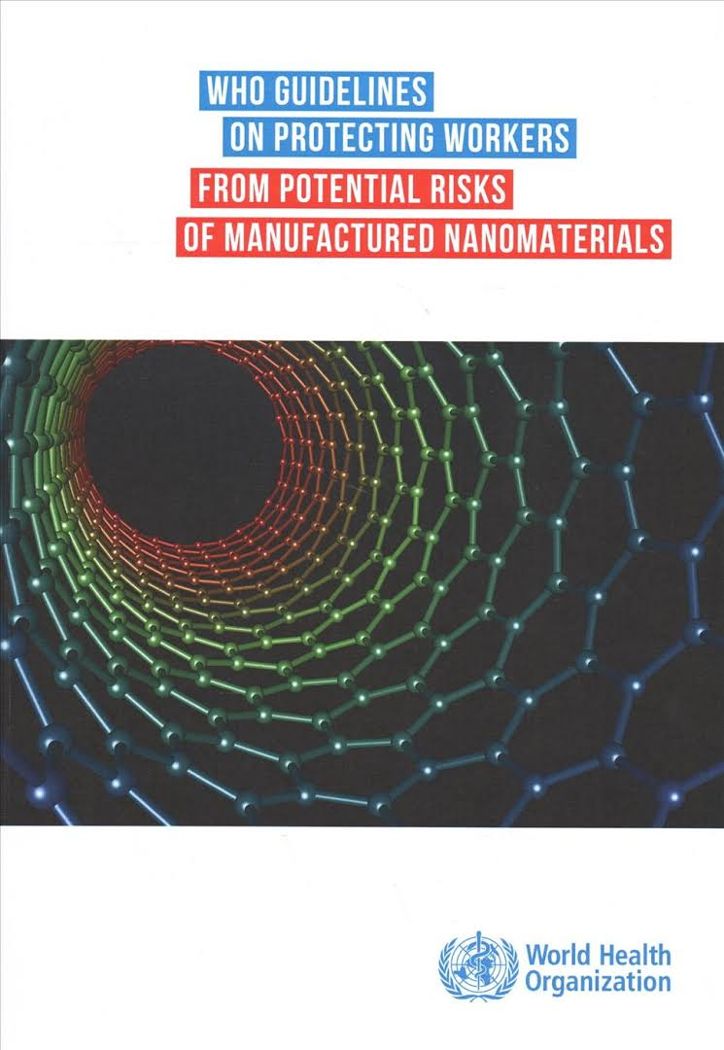

Slide 28
WHO Recommendations
6.1 Assess health hazards of manufactured nanomaterials (MNMs)
6.2 Assess exposures to MNMs
6.3 Control exposure to MNMs
6.4 Health surveillance
6.5 Training and involvement of workers

Slide 29
Translation Science
Example 2: WHO Guidelines for protecting workers
T₀ | Basic Science | Historic and contemporary toxicity data Stakeholder requests
T₁ | Efficacy | PICO analysis (Population, Intervention, Comparison group, Outcome) International expert assessment
T₂ | Effectiveness | Historical practice No studies Cross-sectional and prospective studies
T₃ | Dissemination & Implementation | Implementation plan No D&I research
T₄ | Population Impact | No population data Use of intermediate indicators Longitudinal studies
WHO 2017

Slide 30
Example 3. IRGC White Paper on Nanotechnology Risk Governance

Slide 31
white paper on
RISK GOVERNANCE
TOWARD
AN
S
E
APPROACH
INTEGRATIV
international risk governance council

Slide 32
Journal of Nanoparticle Research (2006) 8: 153-191 © Springer 2006
DOI 10,1007/s11051-006-9092-7
Perspectives
Nanotechnology and the need for risk governance
O. Renn¹ and M.C. Roco^{2,*}
¹Depart of Environmental Sociology, University of Stuttgart, Stuttgart, Germany; ²National Science Foundation, 4201 Wilson Blvd., Arlington, VA 22230, USA; *Author of correspondence (E-mail: mroco@nsf.gov)
Received 15 December 2005; accepted in revised form 12 February 2006
Key words: nanoscience, nanoengineering, global risk governance, risk communication, risk management, scenarios for nanotechnology development,
conceptual framework
Abstract
After identifying the main characteristics and prospects of nanotechnology as an emerging technology, the paper presents the general risks associated with nanotechnology applications and the deficits of the risk governance process today, concluding with recommendations to governments, industry, international organizations and other stakeholders. The International Risk Governance Council (IRGC) has identified a governance gap between the requirements pertaining to the nano- rather the micro-/macro- technologies. The novel attributes of nanotechnology demand different routes for risk-benefit assessment and risk management, and at present, nanotechnology innovation proceeds ahead of the policy and regulatory environment. In the shorter term, the governance gap is significant for those passive nanostructures that currently in production and have high exposure rates ; and is especially significant for the several ‘active’ nanoscale structures and nanosystems that we can expect to be on the market in the near future. Active nanoscale structures and nanosystems have the potential to affect not only human health and the environment but also aspects of social lifestyle, human identity and cultural values. The main recommendations of the report deal with selected higher risk nanotechnology applications, short- and long-term issues, and global models for nanotechnology governance.
Background
Defining Nanotechnology
Nanotechnology is still in an early phase of development, and is sometimes compared in the literature to information technology in the 1960’s and biotechnology in the 1980’s. Nanotechnology refers to the development and application of materials, devices and systems with fundamentally new properties and functions because of their structures in the range of about 1-100 nanometres
(Siegel et al., 1999). It involves the manipulation and/or creation of material structures at the nanoscale, in the atomic, molecular supramolecular realm. At the nanoscale, the characteristics of matter can be significantly changed, particularly under 10-20 nm, because of properties such as the dominance of quantum effects, confinement effects, molecular recognition, and an increase in relative surface area. Downsized material structures of the same chemical elements change their mechanical, optical, magnetic and electronic properties,

Slide 33
IRGC Nanotechnology Risk Policy Recommendations
Improve the knowledge base
Standardise nomenclature measuring and handling systems
Better understanding of risk
Improve data sharing
Understand the full implications
Strengthen risk management structures and processes
Identify gaps and remedies
Development of Voluntary systems
Need to consider anticipatory and coordinated measures for possible events where nano-technology based applications would produce irreversible and significant damage
Promote stakeholder communication and participation
Distinguish between passive and active nanomaterials and products
Improve communication strategies
Engage the public and make participation count
Ensure broad social benefits and acceptance
Stakeholder participation in setting priorities
Funding for the public good
Reduce barriers for developing countries
Economic planning to reduce adverse impacts
Collaboration between stakeholders and nations
(IRGC 2006)

Slide 34
Translation Science
Example 3: International Risk Governance Council guidance on nanotechnology
T₀ | Basic Science | Historic and contemporary toxicity data Explosiveness data Stakeholder request
T₁ | Efficacy | Scoping review on deficit in guidance
T₂ | Effectiveness | No studies Synthesis of evidence for risk governance
T₃ | Dissemination & Implementation | No studies Possible research: extent employers received guidance/best means of dissemination
T₄ | Population Impact | No studies Longitudinal studies
IRGC 2006

Slide 35
Conclusions
There are practically no examples of applied translation science to the ENM worker realm.
There is a need for translation science to be applied to ENM workers’ exposure
If OSH research on ENMs is to lead to worker protection:
More focus on distal end of research-to-impact continuum
Increase collaboration with specialists in translational science
Increase funding of translational science
Utilize findings of translational science research to improve impact

Slide 36
Thank you!
pschulte@cdc.gov
Disclaimer: Disclaimer: The findings and conclusions in this presentation are those of the author and do not necessarily represent the official position of the National Institute for Occupational Safety and Health, Centers for Disease Control and Prevention. Total Worker Health® is a registered trademark of the US Department of Health and Human Services.

