Slide 1
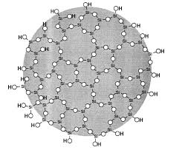


Acute Inhalation Toxicity Part 1: The challenge to create particulate aerosols for acute toxicity testing – a systematic approach
SASforREACH GbR
Juergen Nolde
Grace GmbH / SASforREACH GbR
EU Transparency Register n° 64879142323-90

Slide 2
Acute Inhalation Toxicity Part 1: The challenge to create particulate aerosols for acute toxicity testing – a systematic approach
Table of Content
Working hypothesis – OECD Guidelines and CLP
Particles Behavior and Properties
Test Results of Materials with low Density
Transfer to Inhalation Test Unit
Conclusions
Dr. Juergen Nolde Grace GmbH/SASforREACH GbR

Slide 3
Acute Inhalation Toxicity Part 1: The challenge to create particulate aerosols for acute toxicity testing – a systematic approach
1. Working Hypothesis – OECD Guidelines and CLP
OECD Test Guideline 403/436 Requirements
Particle sizing should be performed for all aerosols and for vapours that may condense to form aerosols. To allow for exposure of all relevant regions of the respiratory tract, aerosols with mass median aerodynamic diameters (MMAD) ranging from 1 to 4 µm with a geometric standard deviation (σg) in the range of 1.5 to 3.0 are recommended
OECD 39 GUIDANCE DOCUMENT ON ACUTE INHALATION TOXICITY TESTING
(7) For some test articles, reliability may be significantly affected if it is difficult to achieve a specific stable target concentration, so elaborate pre-tests without animals may be needed to achieve a specific temporarily stable atmosphere concentration and particle size distribution. It can also be difficult to achieve equivalent chamber concentrations and particle size distributions in the pre-test, sighting study, and main study. This can result in inconsistent responses in the animal studies.
Dr. Juergen Nolde Grace GmbH/SASforREACH GbR

Slide 4
Acute Inhalation Toxicity Part 1: The challenge to create particulate aerosols for acute toxicity testing – a systematic approach
OECD 39 GUIDANCE DOCUMENT ON
ACUTE INHALATION TOXICITY TESTING
…
(51) Achieving the GHS limit concentration of 5 mg/L is technically challenging for most aerosols and greatly exceeds real-world human exposure. It can be difficult or impossible to generate a respirable (MMAD of 1-4 μm) liquid or solid aerosol at this concentration without encountering experimental shortcomings. As aerosol concentration increases, particle size also increases due to the aggregation of solid particles or coalescing of liquid particles. The usual consequences are 1) a decrease in the respirable particle size fraction (and thus reduced toxicity), 2) increased fluctuation and variability in inhalation chamber concentrations accompanied by increased spatial inhomogeneities, 3) overloading of equipment used to characterize test atmospheres, and 4) a divergence of nominal and actual concentrations. At very high concentrations, dry powder aerosols and chemically reactive liquid aerosols (e.g., polymers) tend to form conglomerates in the proximal nose causing physical obstruction of the animals’ airways (e.g., dust loading) and impaired respiration which may be misdiagnosed as a toxic effect.
Dr. Juergen Nolde Grace GmbH/SASforREACH GbR

Slide 5
Acute Inhalation Toxicity Part 1: The challenge to create particulate aerosols for acute toxicity testing – a systematic approach
2. Particles Behavior and Properties
The current basic characterization for materials undergo any inhalation tests is a particle size distribution analysis to determine the particle size and the need of pre-treatment steps to achieve the needed particles at the point of the aerosol generation.
Dr. Juergen Nolde Grace GmbH/SASforREACH GbR

Slide 6




Acute Inhalation Toxicity Part 1: The challenge to create particulate aerosols for acute toxicity testing – a systematic approach
Contact Angle Measurements
No. | Sample | Contact Angle [°] | Remarkes:
1 | AEROSIL® R812 | 147,2 | Drop of water is very difficult or impossible to deposit on the surface Water droplet does not sit firmly on the surface, but can be moved easily
2 | Syloid® 244 FP | not measurable | Drop of water bursts on the surface and runs off immediately
3 | HDK® N20 | 93,6 | Drops of water can be put on easily Slowly sinks in and becomes flatter and more extensive
4 | Socal U152-G | 137,8 | Drop of water is very difficult or impossible to deposit on the surface Water droplet does not sit firmly on the surface, but can be moved easily
5 | Socal UP-G | 35,1 | Drops of water can be put on easily Slowly sinks in
6 | Al2O3 Type FA100 | not measurable | Drops of water can be put on easily Slowly sinks in Uneven drops were created (unequal angles)
7 | Irgazin Red L3630 | 133,1 | Drop of water is very difficult or impossible to deposit on the surface Water droplet does not sit firmly on the surface, but can be moved easily
8 | Syloid® 74 C | <20 | Immediately sinksin and becomes flatter and more extensive
9 | AEROSIL® 200 | 61,5 | Drops of water can be put on easily Slowly sinks in and becomes flatter and more extensive
10 | AEROSIL® OX50 | 96,8 | Drops of water can be put on easily Slowly sinks in and becomes flatter and more extensive
11 | Syloid® 72 | <23 | Immediately sinks in and becomes flatter and more extensive
No 1 to 7 TUD Prof. Stintz and 8 to 11 Grace GmbH
Hofmann et al; Reduction of Acute Inhalation Toxicity Testing in Rats: The Contact Angle of Organic Pigments Predicts Their Suffocation Potential; DOI:10.1089/aivt.2018.0006 (2018)
Dr. Juergen Nolde Grace GmbH/SASforREACH GbR

Slide 7
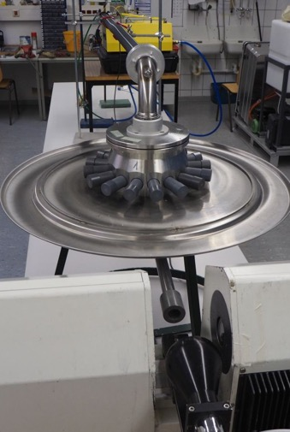
Acute Inhalation Toxicity Part 1: The challenge to create particulate aerosols for acute toxicity testing – a systematic approach
3. Test Results of Materials with low Density
Test Equipment
Picture and drawing TU Dresden
TOPAS Aerosol generator
Fraunhofer test unit with 16 ports
Laser Diffraction Unit
Dr. Juergen Nolde Grace GmbH/SASforREACH GbR

Slide 8
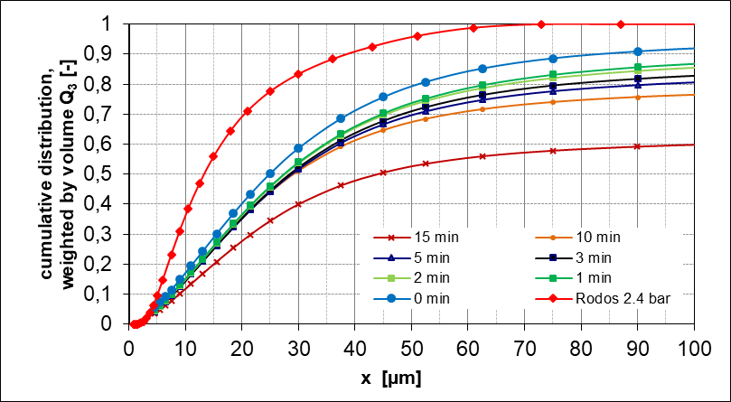
Acute Inhalation Toxicity Part 1: The challenge to create particulate aerosols for acute toxicity testing – a systematic approach
Results HDK® N20
Rodos 2.4 bar: Particle size distribution as (PSD) refence point
0…15 min PSD at the outlet of the inhalation test unit Fraunhofer ITEM depending on the operation time
the aerosol generator and the inhalation test unit were connected by a vertical 1500 mm plastic hose with a diameter of 40 mm
the PSD measurement was done with Laser Diffraction (LD) without further induced shear forces in the free aerosol flow
particle concentration 4700 mg/m³
Dr. Juergen Nolde Grace GmbH/SASforREACH GbR

Slide 9
Acute Inhalation Toxicity Part 1: The challenge to create particulate aerosols for acute toxicity testing – a systematic approach
Back flow chamber from ports
Extreme coating of test unit by agglomeration was observed (see picture). This already indicates that a mechanical obstruction of the upper respiratory tract (nose/nasal cavities) is highly probable.
Pictures show the unit after running a simulation with 4,7 mg/l over a time of approx. 120 min with 42 l/min air flow, test material pyrogenic SAS HDK® N20.
Animal Port
Distribution chamber to ports
Connection hose from aerosol generator to test unit
Photos TU Dresden
Dr. Juergen Nolde Grace GmbH/SASforREACH GbR

Slide 10
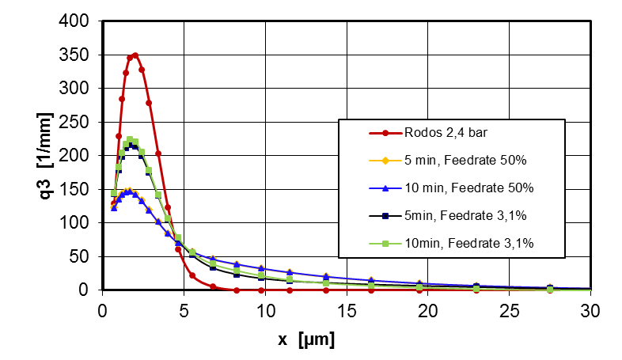
Acute Inhalation Toxicity Part 1: The challenge to create particulate aerosols for acute toxicity testing – a systematic approach
4. Transfer to
Inhalation
Test Unit
Test material
Syloid® 244 FP
Silica gel
untreated
  Particle size distribution (PSD) obtained from laser diffraction at the outlet of inhalation test unit for two different aerosol generator feed rates:
  Time slots of the PSD measurement 5 min and 10 min after start of aerosol generation
  Rodos 2.4 bar – optimum PSD at generation point
  Tobas feed rate 50 % = 7600 mg/m³ at generator equivalent to approx. 5.5 g/m³ at inhalation port
  Tobas feed rate 3.1 % = 700 mg/m³ at generator equivalent to approx. 0.5 g/m³ at inhalation port
Dr. Juergen Nolde Grace GmbH/SASforREACH GbR

Slide 11
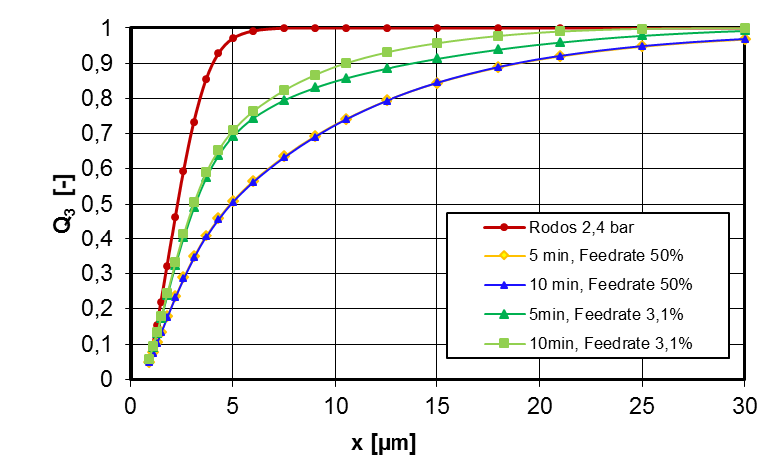
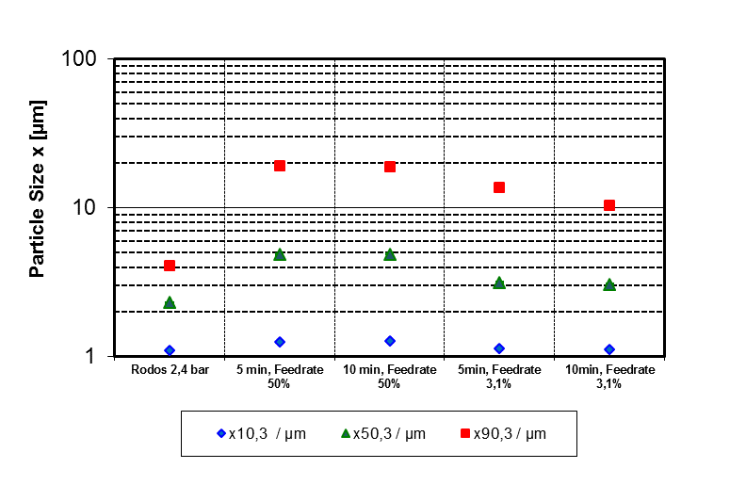
Acute Inhalation Toxicity Part 1: The challenge to create particulate aerosols for acute toxicity testing – a systematic approach
Syloid® 244 FP pre-test in the inhalation test unit Fraunhofer
Determined losses - feed rate 50% previously done in Dresden
Concentration [mg/l]
Time [min]
Dr. Juergen Nolde Grace GmbH/SASforREACH GbR

Slide 12
Acute Inhalation Toxicity Part 1: The challenge to create particulate aerosols for acute toxicity testing – a systematic approach
Animal Port
Connection hose from aerosol generator to test unit
Test unit after 240 min run with
Syloid® 244 FP, coating and precipitation of coarse material can even at the concertation 700 mg/m3 found, however the airborne particle size is only impacted slightly.
Concentration at port is at 500 mg/m3.
Animal Port
Distribution chamber to ports
Test unit outlet
Material deposition at a test concentration of 7600 mg/m³ 25 minutes
Photos TU Dresden
Dr. Juergen Nolde Grace GmbH/SASforREACH GbR

Slide 13
Acute Inhalation Toxicity Part 1: The challenge to create particulate aerosols for acute toxicity testing – a systematic approach
Stability of Test Atmosphere
AEROSIL® R812 simulation over 250 min with
5100 mg/m3
Photos TU Dresden
AEROSIL® R812 over 240 min with 500 mg/m3
Dr. Juergen Nolde Grace GmbH/SASforREACH GbR

Slide 14
Acute Inhalation Toxicity Part 1: The challenge to create particulate aerosols for acute toxicity testing – a systematic approach
Left – proposed shear force free measurement of the PSD at the inhalation test unit outlet
Right – standard measurement using a cascade impactor at one of the ports of the test unit applying shear forces to the aerosols
Photos Fraunhofer ITEM and TU Dresden
Dr. Juergen Nolde Grace GmbH/SASforREACH GbR

Slide 15
Acute Inhalation Toxicity Part 1: The challenge to create particulate aerosols for acute toxicity testing – a systematic approach
PSD - comparison of cascade impactor and laser diffraction after 3 h 50 min test duration for Syloid® 244 FP. The conversion into a geometric particle size x was carried out for an effective particle density of 242 kg/m3 (conversion factor 2)
Dr. Juergen Nolde Grace GmbH/SASforREACH GbR

Slide 16
Acute Inhalation Toxicity Part 1: The challenge to create particulate aerosols for acute toxicity testing – a systematic approach
5. Conclusions
The preliminary results of the aerosol generation part of the mechanistic study show that typical CLP cut off concentrations of the CLP and MMAD< 4 μm required by OECD 403/436 were not achieved with tested powders.
Low density particles (including HMDZ-treated silica) show a strong tendency for re-agglomeration on their way from the aerosol generator to the rat-port
Precipitation in the test unit resulting in variation in particles size and concentration in the air atmosphere occur.
Dr. Juergen Nolde Grace GmbH/SASforREACH GbR

Slide 17
Acute Inhalation Toxicity Part 1: The challenge to create particulate aerosols for acute toxicity testing – a systematic approach
We suggest to carry out a detailed physical investigation of:
Bulk density and tapped density
RODOS and GRADIS measurement to determine the agglomeration behavior under different shear forces
Test with aerosol generator and transport hose to determine the agglomeration and precipitation tendency at different concentrations with laser diffraction measurement
Contact angle measurements (dynamic or at equilibrium)
Technical set-up has to be identical, hose length, hose material, curves, design of the test unit will influence the particle behavior and lead to inconclusive results
Cascade impactor measurements as done today may lead to smaller particle size distribution then actually present due to introduction of shear force during sampling and measurement
Dr. Juergen Nolde Grace GmbH/SASforREACH GbR

Slide 18
Acute Inhalation Toxicity Part 1: The challenge to create particulate aerosols for acute toxicity testing – a systematic approach
Thank you very much for your attention!
Happy to answer your questions!
Acknowledgement:
Thank you very much to Prof. M. Stintz, Dr. B. Wessely and F. Lohse, Research Group Mechanical Process Engineering at Technical University Dresden, Germany, for carrying out all measurements and the ideas to describe the phenomena of aerosol altering in the inhalation test units
Dr. Juergen Nolde Grace GmbH/SASforREACH GbR

Slide 19
Acute Inhalation Toxicity Part 1: The challenge to create particulate aerosols for acute toxicity testing – a systematic approach
Back-up
Dr. Juergen Nolde Grace GmbH/SASforREACH GbR

Slide 20


Acute Inhalation Toxicity Part 1: The challenge to create particulate aerosols for acute toxicity testing – a systematic approach
CLP Classification Category or experimentally obtained acute inhalation toxicity range estimate
Exposure route – dust [mg/L] | Concentration ranges | Label
Category 1 (H330 Fatal if inhaled) | 0 < Cat 1 ≤ 0,05 mg/L
Category 2 (H330 Fatal if inhaled) | 0,05 < Cat 2 ≤ 0,5 mg/L
Category 3 (H331 Toxic if inhaled) | 0,5< Cat 3 ≤ 1,0 mg/L
Category 4 (H332 Harmful if inhaled) | 1,0 < Cat 4 ≤ 5,0 mg/L
Dr. Juergen Nolde Grace GmbH/SASforREACH GbR

Slide 21
Acute Inhalation Toxicity Part 1: The challenge to create particulate aerosols for acute toxicity testing – a systematic approach
Dr. Juergen Nolde Grace GmbH/SASforREACH GbR

Slide 22
Acute Inhalation Toxicity Part 1: The challenge to create particulate aerosols for acute toxicity testing – a systematic approach
Dr. Juergen Nolde Grace GmbH/SASforREACH GbR

