Slide 1


Pulmonary Inflammation, Asthma, and Exhaled Nitric Oxide
Christopher H. Fanta, M.D.
Partners Asthma Center
Pulmonary and Critical Care Medicine Division
Brigham and Women’s Hospital
Harvard Medical School

Slide 2
Conflicts of Interest
None.

Slide 3
Exhaled Breath Biomarkers
Fraction of Exhaled Nitric Oxide (F_{E}NO)
Exhaled Breath Condensate (EBC)
Volatile organic compounds (VOCs)

Slide 4
Exhaled Breath Biomarkers
Fraction of Exhaled Nitric Oxide (F_{E}NO)
Exhaled Breath Condensate (EBC)
Volatile organic compounds (VOCs)

Slide 5
Non-Invasive Assessment of Disease
Airway Diseases
Asthma
Sinus disease
COPD
Cystic fibrosis
Lung diseases
Pulmonary infections
Lung cancer
Pulmonary fibrosis
Systemic diseases
Scleroderma
Diabetes
Renal failure

Slide 6
Non-Invasive Assessment of Disease
Airway Diseases
Asthma
Sinus disease
COPD
Cystic fibrosis
Lung diseases
Pulmonary infections
Lung cancer
Pulmonary fibrosis
Systemic diseases
Scleroderma

Slide 7
Asthma: Quintessential Airway Disease
Characterized by:
Reversible airway narrowing;
Bronchial hyperresponsiveness;
Chronic airway inflammation

Slide 8
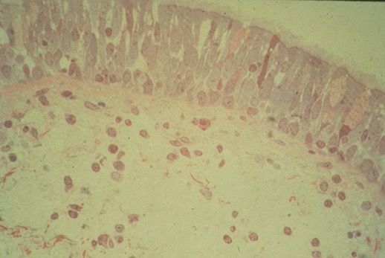
Asthma: Quintessential Airway Disease
Characterized by:
Reversible airway narrowing;
Bronchial hyperresponsiveness;
Chronic airway inflammation
Normal bronchus

Slide 9
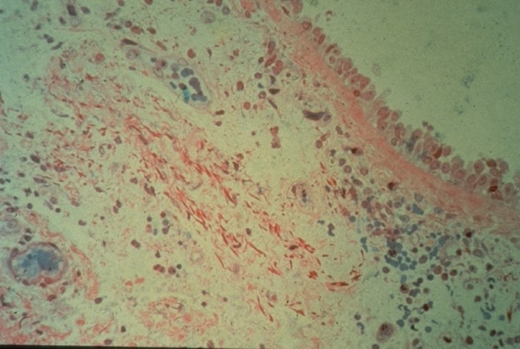
Asthma: Quintessential Airway Disease
Characterized by:
Reversible airway narrowing;
Bronchial hyperresponsiveness;
Chronic airway inflammation
Asthmatic bronchus

Slide 10
Asthma Syndrome Is Heterogeneous
Asthma Phenotypes:
Age of onset
Allergic sensitivities
Severity of regular symptoms
Susceptibility to exacerbations
Response to medications

Slide 11
Asthma Syndrome Is Heterogeneous
Asthma Endotypes:
Eosinophilic (Type-2) inflammation
Neutrophilic inflammation
Pauci-granulocytic inflammation

Slide 12
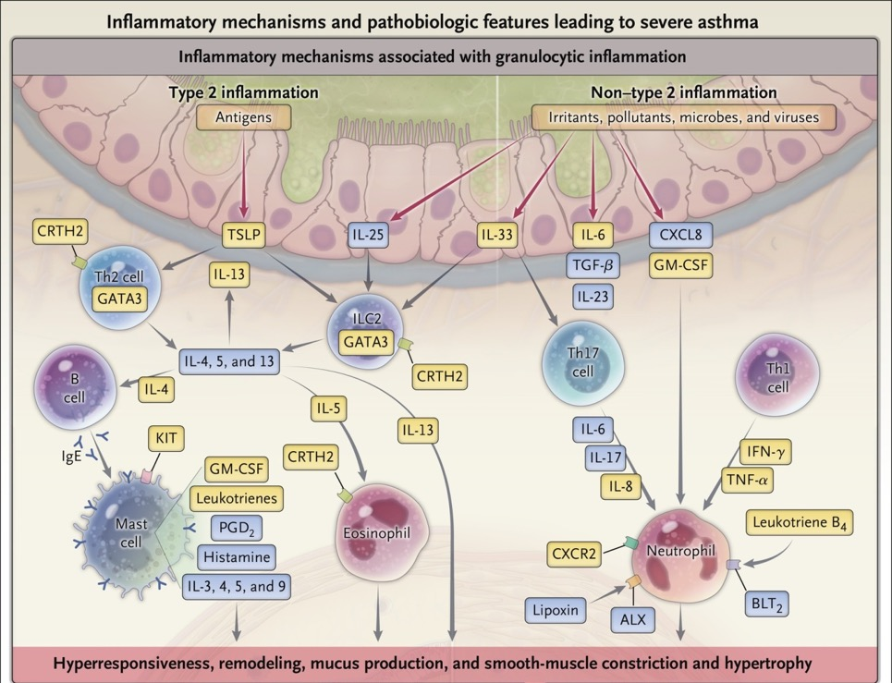
Biochemical Pathways in Severe Asthma
Israel E, et al. NEJM 2017: 377:965-76.

Slide 13
Traditional Disease Markers for Diagnosis and Monitoring Asthma
Measurement of expiratory airflow
  Forced expiratory volume in 1 second (FEV1) or peak expiratory flow (PEF)
Measurement of airway hyperresponsiveness
  Bronchoprovocative challenge (e.g., methacholine, exercise, hyperventilation of cold air)

Slide 14
Traditional Disease Markers of Inflammation in Asthma
Markers of inflammation:
Blood tests for allergy-related proteins (immunoglobulin E) and allergy-related cells (eosinophils)
Bronchoscopic lavage/airway biopsy
Sputum analysis (eosinophils)

Slide 15
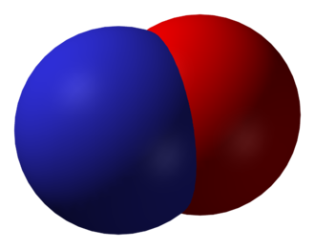
Production of Nitric Oxide (NO)
L-Arginine
+
O2
Nitric Oxide
Nitric oxide synthases

Slide 16
Sources of Inducible Nitric Oxide Synthase (iNOS)
Airway epithelial cells
  Increased in airway inflammation
Especially, eosinophilic airway inflammation

Slide 17
Sources of Inducible Nitric Oxide Synthase (iNOS)
Airway epithelial cells
  Increased in airway inflammation
Eosinophils
Exhaled NO as a surrogate biomarker for airway eosinophilia/Th2 inflammation

Slide 18

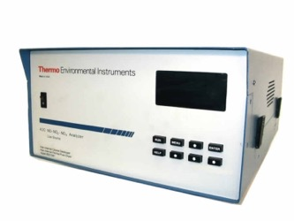
Measurement of Fractional Concentration of Exhaled NO
+

Slide 19
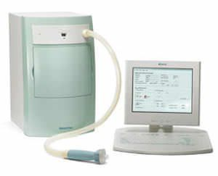
Measurement of Fractional Concentration of Exhaled NO
+
NiOx

Slide 20
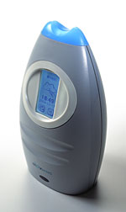
Measurement of Fractional Concentration of Exhaled NO
+
NiOx
NiOx Mino

Slide 21
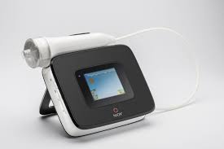
Measurement of Fractional Concentration of Exhaled NO
+
NiOx
Vero
NiOx
NiOx Mino

Slide 22
Measurement of Fractional Concentration of Exhaled NO
10-second exhalation at steady pressure to maintain flow rate 50+5 ml/sec.
Last 3 seconds of exhalation are analyzed by calibrated electrochemical sensor.

Slide 23
Measurement of Fractional Concentration of Exhaled NO
Ox mino use
(1:55-2:44)

Slide 24
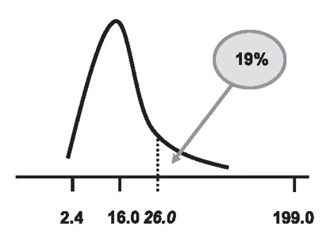
Cut-Off Values for FE_{NO}
Dweik RA, et al. An Official ATS Clinical Practice Guideline. AJRCCM 2011; 184:602-15.

Slide 25
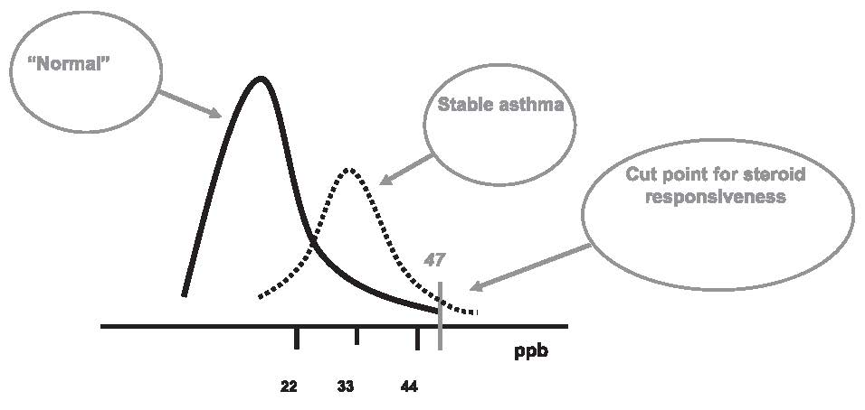
Cut-Off Values for FE_{NO}
Dweik RA, et al. An Official ATS Clinical Practice Guideline. AJRCCM 2011; 184:602-15.

Slide 26
Cut-Off Values for FE_{NO}
Normal: <25 ppb (<20 in children)
Indeterminate: 25 – 50 ppb (20-35 in children)
High: >50 ppb (>35 in children)
Dweik RA, et al. An Official ATS Clinical Practice Guideline. AJRCCM 2011; 184:602-15.

Slide 27
Cut-Off Values for FE_{NO}
Normal: <25 ppb (<20 in children)
Indeterminate: 25 – 50 ppb (20-35 in children)
High: >50 ppb (>35 in children)
Modifiers:
Atopy ( )
Cigarette smoking ( )
Corticosteroid therapy ( )
Other: FVC maneuvers; alcohol consumption; nitrate-rich food intake; mouthwash
Significant change in FE_{NO}:
>20% when FENO >50 ppb
10 ppb when FENO <50 ppb

Slide 28
American Thoracic Society Statement
“a quantitative, noninvasive, simple, and safe method of measuring airway inflammation that provides a complementary tool to other ways of assessing airways disease, including asthma.”
Dweik RA, et al. An Official ATS Clinical Practice Guideline. AJRCCM 2011; 184:602-15.

Slide 29
Potential Utility of Measurement of FE_{NO}
Diagnosis of asthma
Detect eosinophilic inflammation of airways
3. Predict steroid responsiveness in asthma
Useful for monitoring asthma activity
Assess potential medication non-adherence
6. Characterize asthma endotype in severe asthma

Slide 30
Potential Utility of Measurement of FE_{NO}
Diagnosis of asthma
Detect eosinophilic inflammation of airways
3. Predict steroid responsiveness in asthma
Useful for monitoring asthma activity
Assess potential medication non-adherence
6. Characterize asthma endotype in severe asthma

Slide 31
Correlation with Sputum Eosinophilia (>3%)
Retrospective analysis
295 patients seen at asthma clinic (Liege, Belgium)
All had confirmed asthma and both measurement of FE_{NO} and sputum induction.
Schleich FN, et al. Thorax 2010; 65:1039-44.

Slide 32
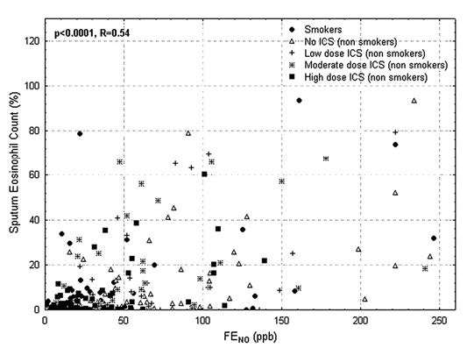
Correlation with Sputum Eosinophilia (>3%)
Schleich FN, et al. Thorax 2010; 65:1039-44.

Slide 33
Correlation with Sputum Eosinophilia
A threshold for FE_{NO} of 42 ppb discriminates between eosinophilic and non-eosinophilic asthma with sensitivity of 63% and specificity 80%.
(p<0.0001 for logistic regression analysis)
Schleich FN, et al. Thorax 2010; 65:1039-44.

Slide 34
Validation of ATS Cut-Off Values: Correlating Sputum Eos
Prospective study of 110 asthma patients at university-based asthma center in Copenhagen.
High FE_{NO} (>50 ppb) | Low FE_{NO} (<25 ppb)
PPV = 77% | NPV = 88%
Jeppegaard M, et al. Respir Med 2018; 144:22-9.

Slide 35
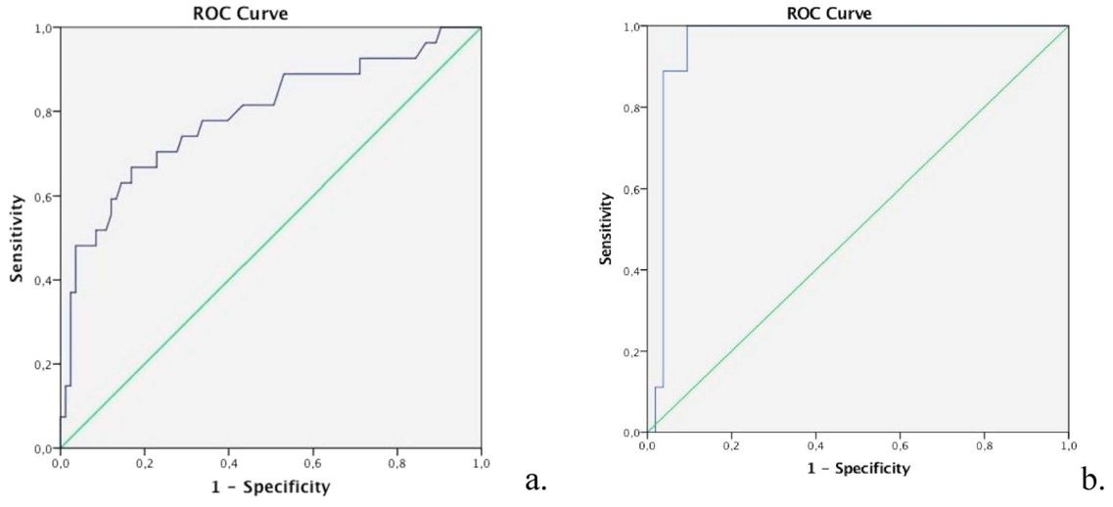
Receiver Operating Characteristic Curves
Total group AUC=0.798
Steroid naive group AUC=0.958
Jeppegaard M, et al. Respir Med 2018; 144:22-9.

Slide 36
Limitations of FE_{NO}
  Considerable overlap between normal and disease
  Influence of modifying factors (age, atopy, sinus disease, cigarette smoking, etc.)
  Dramatic suppression by inhaled corticosteroids
  Values often in a “gray zone” (20-40 ppb)

Slide 37
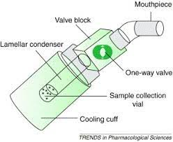
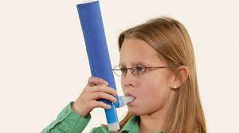
Exhaled Breath Condensate

Slide 38
Exhaled Breath Condensate
Volatile and non-volatile compounds
  Polypeptides
  Proteins
  Nucleic acids
  Lipid mediators
  Inorganic/organic molecules
  Redox-relevant molecules
  pH relevant molecules
  Cytokines, chemokines
Davis, MD, et al. Immmunol Allergy Clin North Am 2012; 32:363-75.

Slide 39
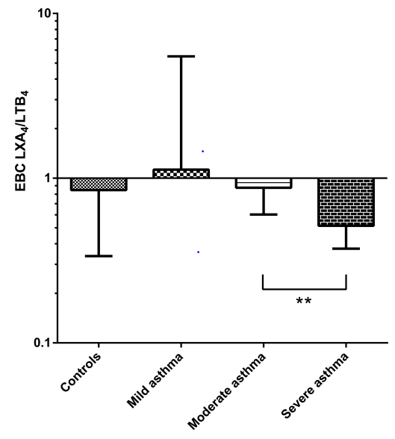
Lipid Mediators in Asthma by EBC
pro-inflammatory leukotrienes
pro-resolving lipoxins
ratio of lipoxins:leukotrienes in severe asthma
Kazani S, et al. J Allergy Clin Immunol 2013; 132:547-753.

Slide 40
VOCs Using Electronic Nose (“Breathomics”)
Diagnostic utility in cancer, infection (including fungal and TB), and airway diseases
Sensor array vs. targeted molecules via gas chromatography:mass spectrometry

Slide 41
VOCs in Asthma
245 asthmatic subjects:
Able to discriminate eosinophilic, neutrophilic, and pauci-granulocytic asthma
Eosinophilic:
Hexane
2-hexanone
Neutrophilic:
Nonanal
1-propanol
Hexane
Schleich FN, et al. Am J Respir Crit Care Med 2019; 200:444-53.

Slide 42
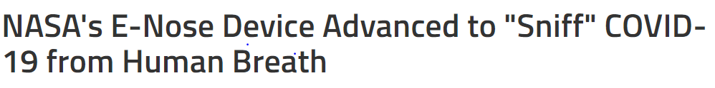
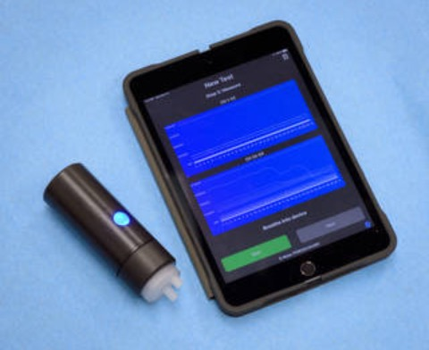
Detection of Covid-19 Infection
NASA Ames Research Center, April 7, 2021

Slide 43
Conclusions
Analysis of components of exhaled breath offers a non-invasive assessment of airway and lung pathology.
Measurement of exhaled nitric oxide concentration has proven to be a useful marker of eosinophilic airway inflammation in asthma and has been successfully commercialized.
The science of exhaled breath analysis is in its infancy and has potential for understanding the inflammatory response to inhaled particles.

